Slide 1
Protecting Colleges and Students
Community College Strategies to Prevent Default
Jee Hang Lee
Vice President for Public Policy and External Relations, ACCT
Dr. Randy Parker
President, Guilford Technical Community College

Slide 2
CDRs on the Rise Three-Year Cohort Default Rate

Slide 3
Report Overview
9 diverse colleges selected
FY 2010 3-year CDR
Data analysis & interviews
Institutional profiles
College practices & policies
Federal policy recommendations

Slide 4
Report Theory of Action
Identify the problem:
Analyze Cohort Data
Develop the solution:
Design, Implement, & Evaluate
Default Reduction Strategies
Improved outcomes:
Reduced Default Rates

Slide 5
Summary of Findings
Clear and strong link between NON-completion and default. Across all colleges in survey:
9% of program completers defaulted, compared to 27% of non-completers
16% of borrowers who completed at least 15 credits defaulted, compared to 38% of those who didn’t complete 15 credits
Efforts to promote student success & completion
are default prevention efforts

Slide 6
Summary of Findings, Cont’d
Apart from completion, more differences than similarities across colleges: in rates, gaps, and the make-up of borrowers
Distribution matters: for example, program completers comprised 13% to 41% of borrowers entering repayment
At some colleges, “higher risk” borrowers at some colleges defaulted at rates similar to lower risk borrowers
Default prevention strategies are not one-size-fits all

Slide 7
Midsize suburban area
Fall 2012 enrollment: 14,793 Headcount
Tuition & Fees: $2,382 | Avg. Net Price: $12,722
72% receive Pell grants ($38M)
35% receive federal student loans ($40M)
60% students of color
Maintaining loan access

Slide 8
GTCC: 3-Year CDR
 | FY 2011 (Draft) | FY 2010 | FY 2009
CDR | 29.9% | 26.0% | 19.0%
Defaulters | 573 | 262 | 166
Borrowers | 1911 | 1005 | 872

Slide 9
How Guilford Tech’s Data Stands Out
43% of borrowers and 63% of defaulters completed fewer than 15 credits
When they drop out matters: 41% default rate for borrowers who withdrew in middle of term
Only one-third of borrowers entering repayment completed loan exit counseling
Those that completed exit counseling: 11% default
Those that did not complete: 33% default
Notes:
Servicer data: 84% of the defaulters in FY 2011 2-year CDR were with one servicer: ACS. ACS was removed as a servicer this last August and their remaining portfolio was distributed to the other participating servicers. No reason was given as to why they were no longer participating, but one can infer that their servicing may not have been up to par.
Defaulters that completed exit counseling: 11.3% defaulted
Borrowers that did not complete counseling: 33.4% defaulted
Just 1/3 of all borrowers completed exist counseling in total – room for growth
Another way to say this is that 40% of non-defaulters completed exit counseling, while only 14.5% of defaulters completed exit counseling.

Slide 10
Urgency at GTCC
Current Strategies
Third-party partnership
Routine data analysis of borrower cohort
Supplemental entrance counseling
Multiple loan disbursements per term
Additional ways to contact students
Borrower outreach at withdrawal, delinquency
Experimental site to limit unsub. borrowing

Slide 11
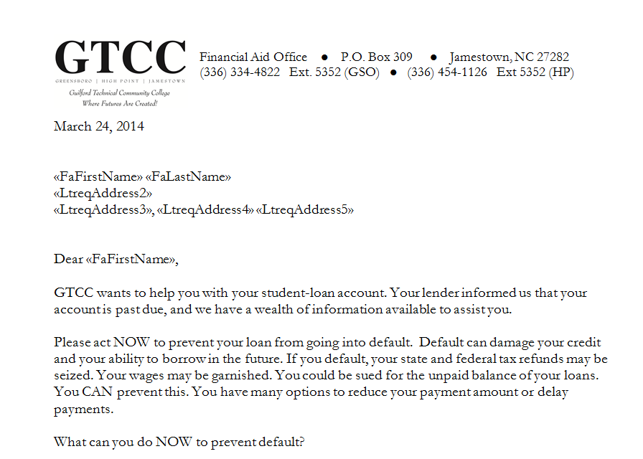
Sample Delinquency Outreach Letter

Slide 12
Institutional Policy Rec’s
Direct Loan participation is important
Routine analysis of CDRs, tailored to college
Default reduction as a campus-wide endeavor
Consider and evaluate third-party partnerships
Reexamine loan packaging policy
College-driven borrower outreach strategies
CDR appeals when necessary

Slide 13
Trustees Can:
Ask for updates on annual CDR releases
Request staff presentation, analysis of available federal loan data
Review third-party contract rec’s to board
Encourage a diversity of options from admin

Slide 14
Federal Policy Recommendations
Congressional Action Needed
Streamline and simplify student loan servicing
Single point-of-contact
Auto-enroll severely delinquent borrowers in IBR
Student Default Risk Index

Slide 15
Federal Policy Recommendations
U.S. Department of Education Action Needed:
Improve CDR appeals
Enhance & exit counseling resources
Make data sources (NSLDS) more user-friendly
Study pro-rating federal loans based on enrollment intensity

Slide 16
Thank You!
Download the report at www.acct.org
For more information, contact:
jhlee@acct.org
202.775.4450

