Slide 1
Open Meetings Law
North Carolina Association of Community College Trustees
April 9, 2015
Q. Shanté Martin, NCCCS General Counsel

Slide 2
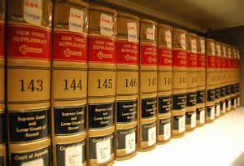
Open Meetings Law N.C.G.S. § 143-318.9 through 143-318.18
The following information is designed to alert you to important aspects of the Open Meetings Law. This handout is not designed to be exhaustive. The intent is to highlight legal information that is relevant to issues that commonly arise related to the Open Meetings Law: 1) misinterpreting what constitutes an “official meeting,” 2) improper use of closed meetings or 3) improper process used to close meetings.
I advise you to consult with your local attorney or contact the NCCCS General Counsel’s office if you have questions related to the Open Meetings Law.

Slide 3
Open Meetings Law N.C.G.S. § 143-318.9 through 143-318.18
“Whereas the public bodies that administer the legislative, policymaking, quasi-judicial, administrative, and advisory functions of North Carolina and its political subdivisions exist solely to conduct the people’s business, it is the public policy of North Carolina that the hearings, deliberations, and actions of these bodies be conducted openly.”

Slide 4
Open Meetings Law N.C.G.S. § 143-318.9 through 143-318.18
Reasons it is imperative for your Board of Trustees to comply with the Open Meetings Law:
Protect trustees from being personally liable for attorneys fees and other fees if an individual trustee intentionally violates the Open Meetings law
Avoid unflattering press coverage
3) Prevent your Board of Trustees from being mired in a hailstorm of media inquiries unrelated to positive college news
Avoid being characterized as untrustworthy by the community who supports our college institutions
Notes:
For bullet #4, when it’s reported that you violated open meetings, your community members will assume you were engaged in illegal behavior, or trying to be dishonest even if it was an honest mistake or misunderstanding. That only serves to stifle your ability to impact your community in all the ways you need to do so.

Slide 5
Open Meetings Law N.C.G.S. § 143-318.9 through 143-318.18
As a general principle, “each official meeting of a public body shall be open to the public, and any person entitled to attend such a meeting.”
Notes:
Emphasize that this is just a general principle and that I will cover the exception to the rule later in the presentation.

Slide 6
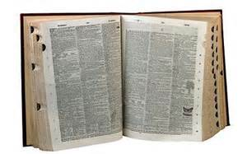
Open Meetings Law N.C.G.S. § 143-318.9 through 143-318.18
To determine whether the general principle that “each official meeting of a public body shall be open to the public, and any person entitled to attend such a meeting” is applicable to community colleges, it is useful to define “public body” and “official meeting.”

Slide 7
Open Meetings Law N.C.G.S. § 143-318.9 through 143-318.18
Definition of “Public Body”

Slide 8
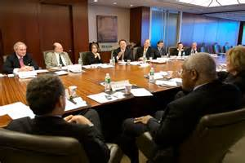
Open Meetings Law N.C.G.S. § 143-318.9 through 143-318.18
To be a “public body,” the following elements must be present:
Be an elected or appointed authority or board that
1) Has at least two (2) members AND
2) Exercises or is authorized to exercise . . . policy- making, quasi-judicial, administrative, or advisory functions

Slide 9
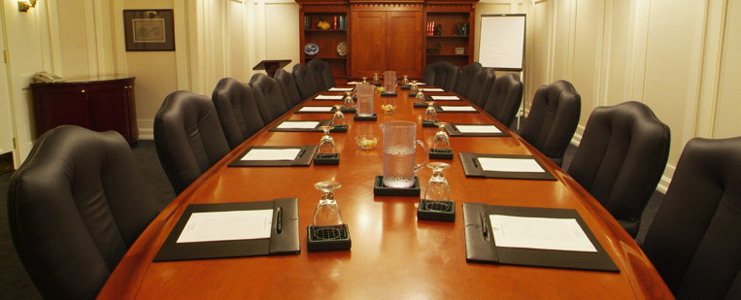
Open Meetings Law N.C.G.S. § 143-318.9 through 143-318.18
Local community college boards of trustees are public bodies because
Members of local boards of trustees are appointed to the board by the Governor and by county boards; AND
Local boards "are composed of two or more members;" AND
Local boards "exercise or is authorized to exercise policy-making" and advisory functions.

Slide 10
Open Meetings Law N.C.G.S. § 143-318.9 through 143-318.18
The definition of “public body” does not include a meeting solely comprised of the professional staff of the public body. For example, when the college President’s staff meets to discuss topics that are going to be discussed at the upcoming Board meeting, those staff persons of the Board do not constitute a “public body.”

Slide 11
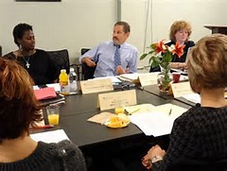
Open Meetings Law N.C.G.S. § 143-318.9 through 143-318.18
Local community college boards of trustees standing and special committees are also public bodies because the definition of public body includes committees. Local board committees
Are members appointed to the board by the Governor and by county boards; AND
Are comprised of two or more members AND
Exercise or have the authority to exercise policy-making and advisory functions.
Thus, standing and special committees have to follow the same procedures dictated by the Open Meetings Law as the full Board of Trustees.
Notes:
Now that we are clear on what constitutes a “public body,” let’s look at what the law says is an “open meeting.”

Slide 12
Open Meetings Law N.C.G.S. § 143-318.9 through 143-318.18
Definition of “Open Meeting”

Slide 13
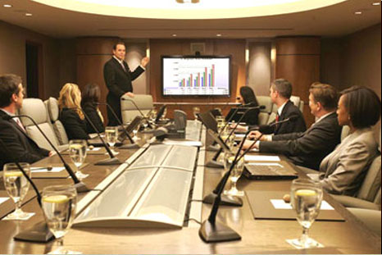
Open Meetings Law N.C.G.S. § 143-318.9 through 143-318.18
To be an “official meeting,” the following elements must be present:
Meeting, assembly, or gathering together at any time or place OR simultaneous communication by electronic means; AND
Majority of the public body’s members; AND
Conduct hearings, participate in deliberations, vote upon or otherwise transact the public business within the jurisdiction, real or apparent, of the public body.

Slide 14
Open Meetings Law N.C.G.S. § 143-318.9 through 143-318.18
The meeting is not an official meeting if the members of the public body gather for social purposes or other informal purposes, UNLESS the social or informal gathering is formed for the purpose of evading the spirit of transparency.

Slide 15
Open Meetings Law N.C.G.S. § 143-318.9 through 143-318.18
For example, if the majority of the board decided to play golf for the purpose of deliberating an upcoming board item, the golf gathering is an official meeting because the social aspect is created to thwart the public’s ability to observe the Board’s business.

Slide 16
Open Meetings Law N.C.G.S. § 143-318.9 through 143-318.18
Applying the “official meeting” definition:
If the Board meets in a non-traditional meeting location such as on the Board Chair’s boat, it does not mean that the meeting does not constitute an “official meeting” because an official meeting could be held at “any time or any place.”

Slide 17
Open Meetings Law N.C.G.S. § 143-318.9 through 143-318.18
Applying the “official meeting” definition:
If the majority of the members of the
public body (includes full board and committees) are not present, it is not an “official meeting.”

Slide 18
Open Meetings Law N.C.G.S. § 143-318.9 through 143-318.18
Applying the “official meeting” definition:
If the majority of the members of the public body gather and do not conduct a hearing, deliberate, vote, or otherwise transact the public’s business, it is not an “official meeting.”

Slide 19
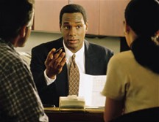
Open Meetings Law N.C.G.S. § 143-318.9 through 143-318.18
Applying the “official meeting” definition:
If you question whether the Board’s gathering will constitute an “official meeting,” it is imperative that you consult with counsel.

Slide 20
Open Meetings Law N.C.G.S. § 143-318.9 through 143-318.18
Closed Sessions
Notes:
Now that we are familiar with what constitutes a public body and what constitutes an official meeting, I now want to turn your attention to closed sessions and how your board can ensure it will stay above the fray.

