Slide 1
THE STATE BUDGET AND LEGISLATIVE PROCESS
Presentation to NCACCT Law/Legislative Seminar
April 4, 2019
Elizabeth Grovenstein, Vice President & Chief Financial Officer
Mary Shuping, Director of Government Relations
NC Community College System

Slide 2
OVERVIEW
Colleges Budgets 101: Funding the Community Colleges
General Assembly Overview: Making Sense of the Process
Getting to $: The Community College System Budget Process from Start to Finish

Slide 3
COLLEGE BUDGETS 101: Funding the Community Colleges

Slide 4
FINANCIAL SUPPORT OF INSTITUTIONS
State
G.S. 115D-31
Operating costs for instruction, administration, and support services
Local
G.S. 115D-32
Operation and maintenance of plant
Capital construction is the legal responsibility of the county. However, G.S. 115D-31 authorizes the State to provide capital funds to local institutions, provided that it is matched on a dollar-to-dollar basis.

Slide 5
NCCCS Total State Budget: FY 2008-2019
Source: BD 701: FY2009-2018 June 30 Authorized Budgets, FY 2018-19 Certified Budget

Slide 6
NCCCS Total State Budget: FY 2008-2019
Source: BD 701: FY2009-2018 June 30 Authorized Budgets, FY 2018-19 Certified Budget

Slide 7
FY 2018-19 STATE AID ALLOTMENTS BY FUND SOURCE
Total: $1.5 billion
Notes:
Over the past few years, tuition and fees have become a more important fund source. In 08-09, tuition receipts only constituted 13% of our budget.

Slide 8
STATE BUDGET ALLOCATIONS
Base Allocations – All colleges get the same amount regardless of size or performance.
FTE Allocations – Depends on the number of FTE students served.
Performance-Based Allocations - Depends on student outcomes.

Slide 9
College Allotments: FY 2018-19
$ 871.3 m
59%
Total Allotments: $1.49 billion
Less Management Flex Cut: $0.05 billion
Net Allotments: $1.44 billion
$508 m
34%
$32.6 m
2%
$51.5m 3%
Source: FY 2018-19 Summary of Budget Allocations. Note that this graph only captures funds distributed to colleges through the routine budget allocation process. This graph does NOT account for any subsequent reversions required by the Governor or allocations.
Notes:
Purple = BASE; Red = FTE; Green = PERFORMANCE

Slide 10
Budget FTE
1 FTE = 512 Student Hours in Membership as defined in 1G SBCCC 100.1(5)
For each instructional area (curriculum, con ed, and basic skills), a college’s budget FTE is determined by calculating the higher of :
the prior year; or
the average of the two previous years’ enrollment

Slide 11
TIERED FUNDING
Tier 1A
Curriculum (CU) courses in programs leading to immediate employment and Con Ed courses that lead to same 3rd party credential
Tier 1B
Other CU technical, health science, lab-based science, and college-level math courses; Con Ed courses leading to a 3rd party credential for priority occupations
Tier 2
All other curriculum courses and con. ed. courses leading to a
3rd party credential
Tier 3
All other continuing education courses

Slide 12
BUDGET FLEXIBILITY
The General Assembly has allowed colleges to have flexibility in order to meet individual college needs
Formulas are for allocation purposes only
Colleges can spend the money however they choose with the following exceptions:
Basic Skills funding may only be used for basic skills programs
Federal vocational education funding may not be transferred
Customized Training funds may not be transferred
Certain State-supported allocations approved by the State Board outside the budget package

Slide 13
OTHER BUDGET ISSUES
Management Flex Cuts
Usually General Assembly will specify where cuts made
Budget cut enacted by General Assembly; colleges are authorized to determine where to reduce spending
Reversions & Spending Freezes
Governor determines will be budget shortfall and requires agencies to revert funds
May also frees travel, hiring, purchasing, etc.
Tuition Shortfalls/Budget Call-Backs
Happens when tuition and fee receipts are less than the amount budgeted to be collected
Requires colleges to reduce budgets

Slide 14
OTHER BUDGET ISSUES (cont’d)
Carryforward
Generally, all unspent State funds must revert at the end of the fiscal year
Statutes authorize community colleges to carry forward some funds, e.g., performance funds
System Office requests carryforward from OSBM under this authority
Tuition Increases
General Assembly or Governor usually propose.
Revenue shortfalls or to fund new programs

Slide 15
GENERAL ASSEMBLY OVERVIEW: Making Sense of the Process

Slide 16
2019-21 MAKE-UP OF THE GENERAL ASSEMBLY
House
2 year terms
120 total members
65 Republicans (-9 seats)
55 Democrats (+9 seats)
24 Freshmen
15 Democrats
9 Republicans
Senate
2 year terms
50 total members
29 Republicans (-6 seats)
21 Democrats (+6 seats)
14 Freshmen
7 Republicans
2 are former House members
7 Democrats

Slide 17
CONVENING OF LEGISLATIVE SESSIONS
REGULAR SESSIONS
Odd-Numbered Years: “Long Sessions” Constitutionally required Mid-January 2 Year biennial budgets Major legislative initiatives Any legislator can introduce a bill on any subject | Even-Numbered Years: “Short Sessions” Long session adjournment resolution controls Mid-May Only certain bills eligible Typically budget adjustment bill
SPECIAL SESSIONS
Called by Governor or 3/5 vote of House & Senate
Natural disasters, responses to court orders, etc.
Can be veto override sessions, depending if legislature adjourned prior to veto

Slide 18
INTERIM
Between regular sessions
Study committees appointed by Speaker and President Pro Tem
Report to General Assembly with legislative recommendations
Joint Legislative Education Oversight Committee (“Ed. Oversight)
Others dealing with economic development, IT, etc.

Slide 19
From Introduction to Enactment: Steps in the Legislative Process
Originating Chamber | Receiving Chamber | Return to Originating Chamber/Conference | Enactment
Introduction & Sponsorship 1st reading & referral to standing committee Committee Process Committee chair controls Open Meetings Law Proposed Committee Substitutes often offered Amendments Documents become public Voting House Education-Community Colleges & Senate Education/Higher Education Floor Debate Added to calendar Sponsor explains; other members support or oppose Amendments If passes 2nd & 3rd reading, sent to other chamber | 4. Same process Committee(s) Floor Debate Very Rarely does the other chamber not make a change to a bill! | Concur or fail to concur in changes made by other chamber Sometimes, the originating chamber concurs in the changes. If so, the bill is ratified & sent to the Governor → IF NOT Conference Committee appointed to resolve differences. Members from House & Senate. Conference Committee meetings not subject to Open Meetings Law Conference Report voted on in both Chambers Conference Report cannot be amended | Bill ratified & sent to Governor During session, 10 days to sign or veto. Otherwise becomes law. After adjournment has 30 days to act. Signs or does not veto Becomes law on date specified in bill. Vetoes General Assembly can override 3/5 vote of both chambers Current General Assembly has “veto proof majority”

Slide 20
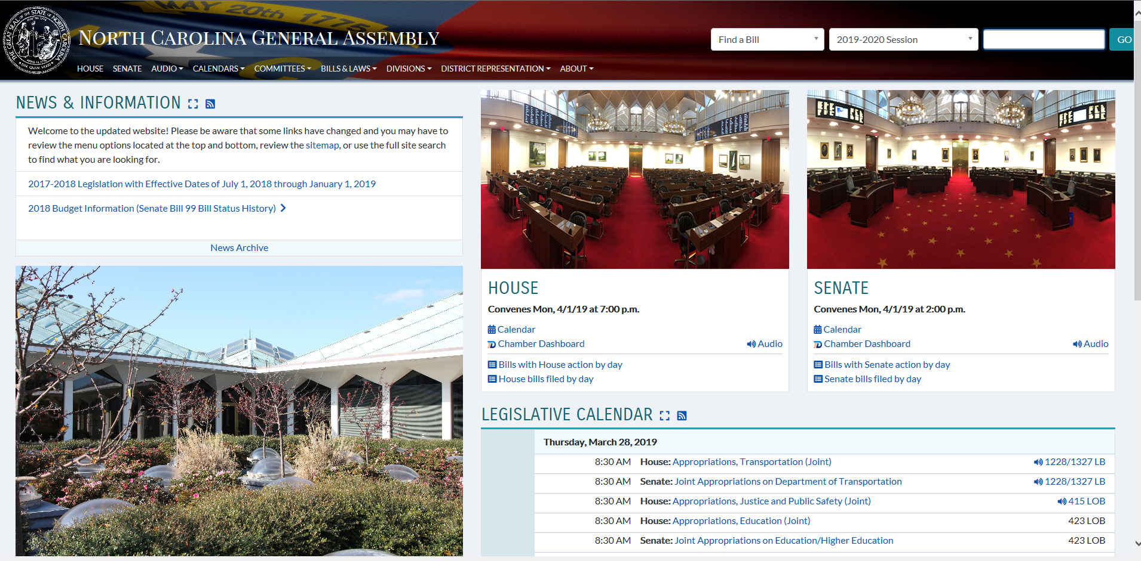
www.ncleg.gov

Slide 21
Hints on Tracking Legislation
House and Senate often introduce identical bills
Individual bills are often “added to” other bills in a proposed committee substitute
Especially true in budget
Just because bill shows up on website as being in committee doesn’t mean it isn’t in another bill
Proposed committee substitute offered in committee may look nothing like it did when it was referred to the committee!
Substantial changes to same subject matter
Completely different subject matter from original bill
Important to attend committee meetings
Vigilance, especially at end of session!
“Cross-over” Date – date in the House and Senate rules by which all non-money bills must have “crossed-over” from one chamber to the other in order to remain eligible for the remainder of the long session and the short session

Slide 22
GETTING TO $: The Community College System Budget Process from Start to Finish

Slide 23
SOURCES OF BUDGET & LEGISLATIVE AGENDA ITEMS
COMMUNITY COLLEGES
OTHER SOURCES
NC Assn. of CC Presidents (NCACCP) Legislative & Finance Committees
Begins in mid-summer
Approved by NCACCP
Align to CC System’s Strategic Plan
Presented to State Board of Community Colleges (SBCC)
NCACCT
CONSENSUS BUDGET/ LEGISLATIVE PRIORITIES ESSENTIAL!
Governor’s Budget
Legislators’ priorities/interests beneficial to community colleges
Legislative Study Commission recommendations supporting CC mission
Studies done by CC System that are mandated by legislature

Slide 24
LEGISLATIVE BUDGET PROCESS
System Office -- Work with
House & Senate Education Appropriations Subcommittee Chairs
Responsible for CC, UNC, & K-12 budgets
House & Senate Full Appropriations Chairs
Presidents & Trustees – Work with local legislative delegation
System President – Speaker & President Pro Tem

Slide 25
LEGISLATIVE BUDGET PROCESS
Ultimately final budget is product of Community College System budget priorities, other legislators’ priorities, and constrained by funding amounts.
Leadership sets “targets” – amount of money that can be spent by the subcommittee to support programs
Can get “additional money” through cuts
Salaries and benefits are “outside the subcommittee targets” meaning those items are dealt with by the full Appropriations Committee
System President makes budget presentation to “Ed. Approps.” Subcommittee always in long session; sometimes in short session
Work on-going throughout session until budget is passed
Priorities may shift after House and Senate budgets are introduced.

Slide 26
SPECIAL FUNDS FOR INDIVIDUAL COLLEGES
Non-recurring or recurring funds
Typically non-recurring
May be allocated outside the Education of the budget
May not be part of the Education spending “targets” given to Education Appropriations Sub-chairs
Often, individual legislators will request special projects/funding for district
System Office typically opposes if takes away from agreed upon System priorities

Slide 27
2019-2020 BUDGET PRIORITIES
Fund short-term workforce programs in Tier 1A, 1B, & 2 at the same rate as curriculum programs. $12 million
Fund Workforce Development focused Information Technology System for colleges. $15 million
Increase faculty & staff salary & work toward national average
State Board approved multi-campus centers. $2.3 million
Expand Career Coach Program. $2.8 million
Stabilize budgets for Hurricane Florence Impacted Colleges. $6.8 million one time funds

Slide 28
Joint CC & UNC System Priorities
Summer Scholarships -- $3 million 2019-20 & $4 million 2019-21
CC Student Transfer Scholarships -- $4 million
Improve Credit Transfer for CC & Military-Affiliated Students -- $150,000 recurring; $200,000 non-recurring
Expand Available Open Educational Resources -- $300,000 recurring

Slide 29
Governor’s Budget
Includes most of our budget priorities
Short-term workforce training funding parity
IT funds (nonrecurring)
Multi-Campus funding
Expand Career Coach program
NC GROW (Getting Ready for Opportunities in the Workforce)
$30 million for tuition & fees for CU students enrolled in high demand fields
$5 million (2019-20) & $10 million (2020-21) for students enrolling in non-credit, short-term workforce training programs leading to industry credential

Slide 30
ADVOCACY: The Critical Importance of Trustees

Slide 31
THE COMMUNITY COLLEGE SYSTEM PROCESS DURING SESSION
Weekly Legislative Update Teleconferences
Budget Tracking Sheets
Legislative Tracking Sheets
Ad Hoc Communications
Bills introduced that impact community colleges
Notify presidents either on weekly call or via e-mail if urgent
If bill support or oppose scheduled, notify presidents via e-mail
Work closely with Chair of NCACCP Legislative Committee to get
State Board of Community Colleges
Relationships with members
Very engaged on budget priorities

Slide 32
TRUSTEES
58 local boards of trustees
Over 800 strong
Have an association – NCACCT
Appointees either by Governor or locally
RESULT: Organized & have a strong, state-wide voice!

Slide 33
ADVOCACY Q&A
What is the best way for local trustees to get involved in the legislative process?
Build relationships
Invite legislators to campus
Get to know entire legislative delegation before asking for help
Listen
Know as much as possible about the issue
Engage other members of community, especially business, employers
What is the timeline for approaching legislators on budget issues?
ASAP after priorities decided
ON-GOING throughout session
What is the best way to contact legislators?
Phone calls or emails?
Home, office, cell?
Legislative Assistant or direct?
Should there be a coordinated effort in contacting legislators or should it be individual?
“It depends”
What is the best way to keep the System Office informed on local discussions and relationships with legislators?

Slide 34
QUESTIONS?
Elizabeth Grovenstein, VP/CFO
NC Community College System
(O) 919-807-7070
grovensteine@nccommunitycolleges.edu
Mary Shuping, Director of Government Relations
NC Community College System
919-807-6957
919-795-1636
shupingm@nccommunitycolleges.edu

