Slide 1
Open Government and the Community College
NCACCT Law-Legislative Seminar
Robert Joyce
UNC School of Government
March 30, 2023

Slide 2
It Ain’t Always Easy

Slide 3
It Ain’t Always Easy
UNC is a governmental agency subject to the state Public Records Law.

Slide 4
It Ain’t Always Easy
UNC is a governmental agency subject to the state Public Records Law.
UNC is a postsecondary institution subject to the federal Family Educational Rights and Privacy Act.

Slide 5
It Ain’t Always Easy
UNC is a governmental agency subject to the state Public Records Law.
UNC is a postsecondary institution subject to the federal Family Educational Rights and Privacy Act.
Federal law trumps state law.

Slide 6
It Ain’t Always Easy
UNC, as required by Title IX, conducts hearings regarding allegations of sexual misconduct by students.

Slide 7
It Ain’t Always Easy
Newspapers put in a public records request under the state Public Records Law.

Slide 8
It Ain’t Always Easy
The request is for the names of students found to be responsible for “rape, sexual assault, or any related or lesser included sexual misconduct.”

Slide 9
It Ain’t Always Easy
The request is for the names of students found to be responsible for “rape, sexual assault, or any related or lesser included sexual misconduct.”
GIVE US THE RECORDS!

Slide 10
It Ain’t Always Easy
UNC says it cannot give those records up. It says FERPA prohibits the disclosure, because the records are “education records” within the meaning of FERPA.

Slide 11
It Ain’t Always Easy
UNC says it cannot give those records up. It says FERPA prohibits the disclosure, because the records are “education records” within the meaning of FERPA.
WE CAN’T GIVE YOU THE RECORDS!

Slide 12
It Ain’t Always Easy
Newspapers: SURE YOU CAN.
“Nothing . . . shall be construed to prohibit an institution of postsecondary education from disclosing the final results of any disciplinary proceeding . . . against a student who is an alleged perpetrator of any crime of violence . . . or a nonforcible sex offense,” if the student was found in violation.
GIVE US THE RECORDS!

Slide 13
It Ain’t Always Easy
UNC: NO WE WON’T.
FERPA, a federal law, trumps state law. FERPA says we don’t have to keep these records confidential, but it doesn’t say we have to give them up. There are good reasons FERPA doesn’t make us.
WE WON’T GIVE THEM UP!

Slide 15
ID10T

Slide 16
Public Records

Slide 17
Public Records Philosophy
The public records of the agencies of government in North Carolina “are the property of the people.”
GS 132-1

Slide 18
The Basics: Public Records
Any record made or received in the transaction of public business is subject to public access unless an exception applies.

Slide 19
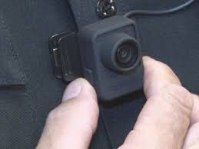
What is a “Record”?
Types and forms of records defined: Documents, papers, letters, maps, books, photographs, films, sound recordings, magnetic or other tapes, electronic data-processing records, artifacts, or other documentary material, regardless of physical form or characteristics.

Slide 20
Does a Record Exist?
Access is to records, not to information.

Slide 21
Does a Record Exist?
Nothing in this section shall be construed to require a public agency to respond to a request for a copy of a public record by creating or compiling a record that does not exist.
GS 132-6.2(e)

Slide 22
Does a Record Exist?
If a public agency, as a service to the requester, voluntarily elects to create or compile a record, it may negotiate a reasonable charge for the service with the requester.
GS 132-6.2(e)

Slide 23
Who Gets to See Public Records?

Slide 24
Who Gets to See Public Records?
Every custodian of public records shall permit any record in the custodian's custody to be inspected and examined at reasonable times and under reasonable supervision by any person . . .
GS 132-6(a)

Slide 25
Why Do You Want to See It Anyway?

Slide 26
Why Do You Want to See It Anyway?
No person requesting to inspect and examine public records, or to obtain copies thereof, shall be required to disclose the purpose or motive for the request.
GS 132-6(b)

Slide 27
Was it Made or Received in Public Business?

Slide 28
Was it Made or Received in Public Business?
"Public record" or "public records" shall mean all documents, papers, [etc.] made or received pursuant to law or ordinance in connection with the transaction of public business by any agency of North Carolina government or its subdivisions.
GS 132-1

Slide 29
Was it Made or Received in Public Business?
The content of the record answers that question.

Slide 30
Rule to Remember
It’s the CONTENT of the record, not its location, that determines whether it is a public record.

Slide 31
2 Key Concepts
Records created on personal devices or accounts are public records if the content involves public business.
Records created on government devices or accounts are not public records if the content does not involves public business.

Slide 32
There are Exceptions

Slide 33
There are Exceptions
An exception may say one of two things about a record

Slide 34
There are Exceptions
An exception may say one of two things about a record
It is “not a public record”: agency is not required to provide access, has discretion to do so
Examples: Criminal investigation records, utility billing information, economic development information

Slide 35
There are Exceptions
An exception may say one of two things about a record
It is “not a public record”: agency is not required to provide access, has discretion to do so
Examples: Criminal investigation records, utility billing information, economic development information
It is “confidential”: agency is prohibited from providing except as specifically authorized by law
Examples: Social security numbers, client information, juvenile information, certain health information, education records

Slide 36
The Biggest Exception

Slide 37
The Biggest Exception
Personnel records are confidential

Slide 38
Exception to the Biggest Exception
Some personnel information is public

Slide 39
Exception to the Biggest Exception
Name
Age
Date of hire
Terms of contract
Salary history
Date and type of certain personnel actions

Slide 40
Exception to the Biggest Exception
Information, not records

Slide 41
Drafts

Slide 42
There is No Exception for Drafts

Slide 43
What Can We Charge?

Slide 44
What Can We Charge?
Actual, direct costs only
Not personnel time

Slide 45
Confidential Student Records
FERPA vs. the Public Records Law

Slide 46
Confidential Student Records
FERPA makes education records confidential and they are therefore an exception to the Public Records Law
But FERPA says it does not prohibit disclosure of the sex offense records
So must UNC give up the sex offense records?

Slide 47
Confidential Student Records
“We hold that officials of The University of North Carolina at Chapel Hill are required to release as public records certain disciplinary records of its students who have been found to have violated UNC-CH’s sexual assault policy. [FERPA authorizes the disclosure.] Accordingly, as an agency of the state, UNC-CH must comply with the North Carolina Public Records Act.”
DTH Media Corporation v. Folt
374 N.C. 292 (2020)

Slide 49
Open Meetings

Slide 50
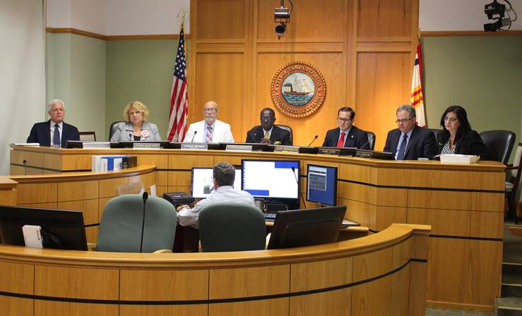
What meetings are subject to open meetings requirements?
“Official meetings” of “public bodies”

Slide 51
What’s a Public Body?
Public Body
Functions
2 or more members
Intentionally created or appointed
Governmental (not private)
Exercising any one of 5 functions
Legislative
Policy-making
Quasi-judicial
Administrative
Advisory
Does not apply to meetings solely among staff.

Slide 52
What’s an Official Meeting?
A majority of the members
Gathering simultaneously in person or electronically
To conduct a hearing, deliberate, vote, or otherwise conduct public business.

Slide 53
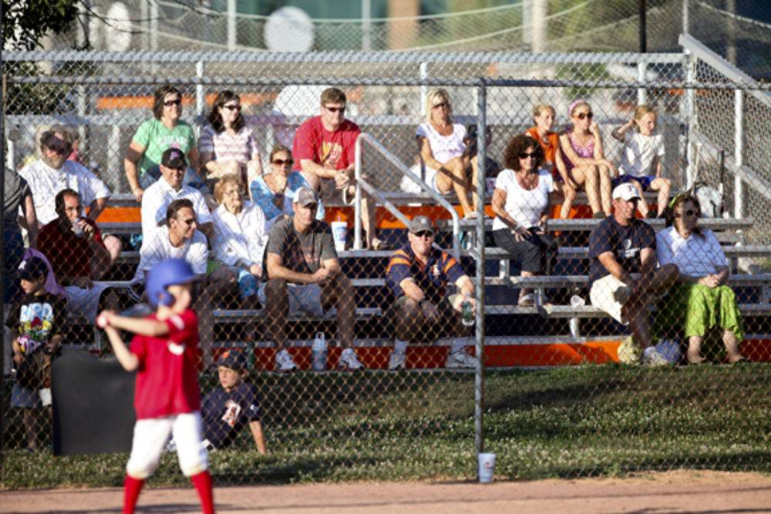
A purely social occasion is not an official meeting.

Slide 54
Electronic Meetings
Majority of a public body interacting in an electronic conversation that is essentially simultaneous may constitute a meeting.

Slide 55
The Right of Access
Public and press can record, video, and photograph meetings
Right to attend does not include right to be heard.

Slide 56
Closed Sessions
Limited authority to meet in closed session
Process: Motion made in open session, stating purpose of closed session

Slide 57
Closed Session Purposes*
Preserve confidentiality of records
Preserve attorney client privilege
Discuss location or expansion of business or industry; economic incentives
Discuss bargaining position for property acquisition
Consider performance, qualifications, appointment, of public employees and public officers (not members of the board itself or other boards)
Matters involving alleged criminal misconduct
*Partial list: See G.S. 143-318.11 for complete description.

Slide 58
Closed Session Myths
Myth: Council cannot vote or take action in closed session.
Truth: Some closed session provisions specifically allow it.
Myth: It’s illegal to talk publicly about what happens in closed session.
Truth: Statute doesn’t prohibit it, but some topics are confidential under other laws.

