Slide 1
THE ECONOMY IN 2023:
MEETING THE CHALLENGES OF THE
LABOR MARKET, INFLATION, RECESSION
AND – POSSIBILITY - A BANKING CRISIS
Dr. Michael L. Walden, Reynolds Distinguished Professor Emeritus
North Carolina State University

Slide 2
THE ECONOMIC RECOVERY FROM THE PANDMIC CONTINUES
(QUARTERLY REAL GDP AS PERCENT OF 2019 IV REAL GDP)
Notes:
First quarter drop due to imports

Slide 3
A CLOSER LOOK AT THE US, NC, AND
MAJOR METROS
% CHANGE IN REAL (INFLATION-ADJUSTED) GDP
2019-2020 2020-2021
US -2.8% 5.9%
NC -1.2% 7.0%
RALEIGH 0.2% 12.1%
CHARLOTTE 1.3% 6.7%
DURHAM-CH 1.1% 7.8%

Slide 4
FOCUS ON “BIG 3” ISSUES
LABOR MARKET
INFLATION
RECESSION

Slide 5
TW0 PICTURES OF THE LABOR MARKET
Notes:
Construction employment has recovered in north carolina

Slide 6
WHAT’S HOLDING BACK THE LABOR FORCE?
* SLOW POPOULATION GROWTH
* AGING POPULATION
* DECLINE IN LABOR FORCE PARTICIPATION OF ELDERLY – SURGE IN RETIREMENTS
* DECLINE IN LABOR FORCE PARTICIPATION OF 18-24 YEAR OLDS
* MY ANALYSIS SUGGESTS NC WILL HAVE ADEQUATE LABOR IF IN-MIGRATION CONTINUES
* HOWEVER, SOME LABOR WITHIN THE STATE WILL NEED TO BE GEOGRAPHICALLY RE-LOCATED
Notes:
4.5 million fewer individuals employed than prior to the pandemic; Univ. Chicago estimates 1.5 million fewer people work due to the enhanced child tax credits

Slide 7
ALSO, A RE-ALLOCATION OF WORKERS OCCURRED
MANY WORKERS USED THE TIME AND
FINANCIAL SUPPORT DURING THE
PANDEMIC TO IMPROVE THEIR SKILLS
AND MOVE TO HIGHER PAYING JOBS

Slide 8
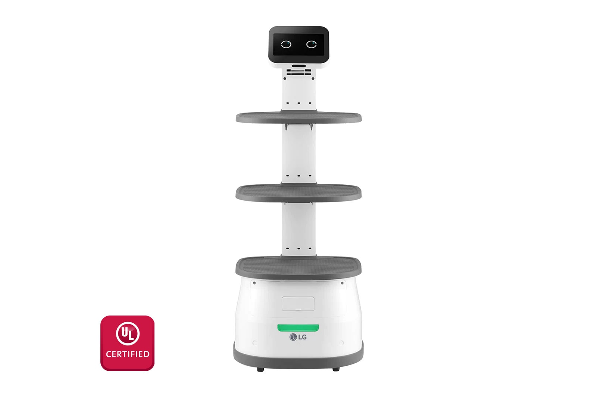
MORE TECHNOLOGY WILL REPLACE WORKERS
MCDONALD’S RECENT TEST OF A DIGITAL ONLY RESTAURANT

Slide 9
PATH OF INFLATION: YEAR-OVER-YEAR
(% CHANGE)

Slide 10

WHAT INITIALLY CAUSED INFLATION?
DEMAND (BUYING) EXCEEDED SUPPLY (PRODUCTION)
STIMULUS PROGRAMS
SUPPLY-CHAIN PROBLEMS

Slide 11

WHY HAS INFLATION RATE MODERATED?
”SUPPLY CHAIN” HAS
IMPROVED

Slide 12
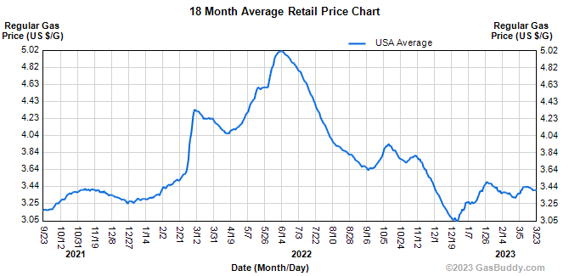
WHY HAS INFLATION RATE MODERATED?
GAS PRICES HAVE RETREATED
US AND WORLD PRODUCTION UP 16% SINCE THE COVID RECESSION
CHINA’S USE DOWN, BUT IS COMING BACK

Slide 13
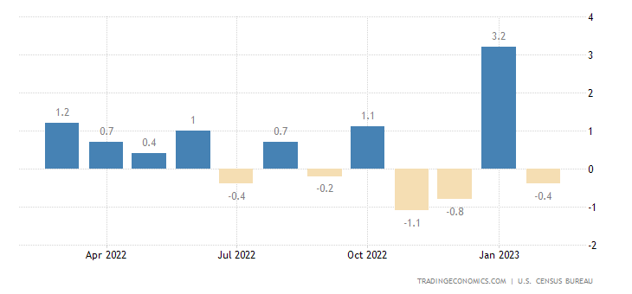
WHY HAS INFLATION RATE MODERATED?
MONTH-OVER-MONTH CHANGE IN RETAIL SALES HAVE FALLEN IN 3 OUT OF LAST 4 MONTHS

Slide 14
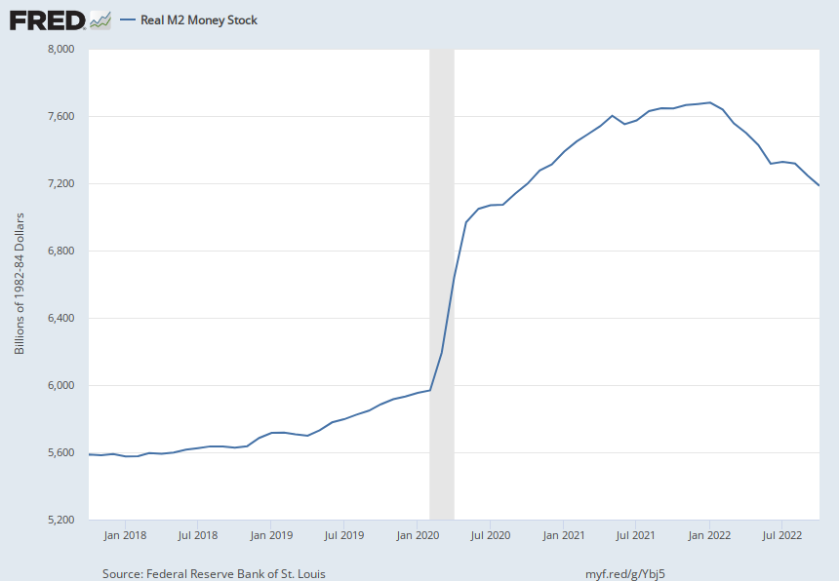
ALSO, FEDERAL RESERVE HAS PULLED
MONEY OUT OF THE ECONOMY

Slide 15
EXPECTED PATH OF INFLATION
IF FEDERAL RESERVE STICKS TO ITS ANNOUNCED PLAN OF RAISNG INTEREST RATES AND SLOWING THE ECONOMY, AT END OF 2023 THE YEAR-OVER-YEAR INFLATION RATE WILL BE BETWEEN 3% AND 4%.
QUESTION IS WHETHER THAT CAN HAPPEN WITHOUT A RECESSION

Slide 16
WHAT IS A RECESSION?
A BROAD-BASED DECLINE IN ECONOMIC
ACTIVITY THAT LASTS FOR A SIGNIFICANT
PERIOD OF TIME

Slide 17
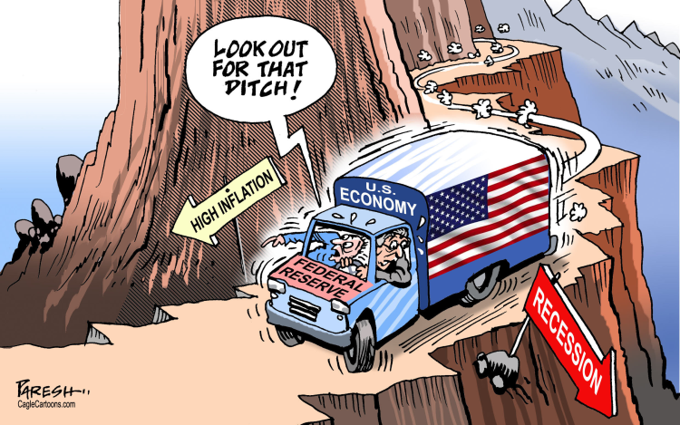
RECESSION IS OFTEN THE “MEDICINE” TO CURE HIGH INFLATION
FEDERAL RESERVE (FED) TRIES TO SLOW SPENDING TO TAKE PRESSURE OFF PRICES

Slide 18
FEDERAL RESERVE HELPED STIMULATE SPENDING DURING
COVID; NOW IT IS USING ITS TOOLS TO DO THE OPPOSITE

Slide 19
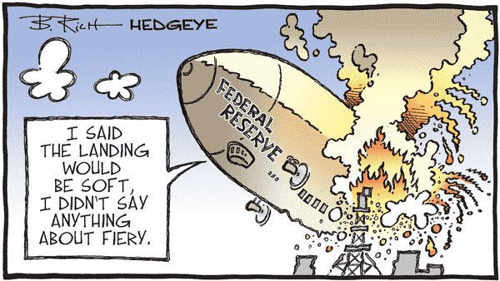
FED WANTS TO ACHIEVE A “SOFT LANDING”: LOWER
INFLATION RATE WITHOUT CRASHING THE ECONOMY

Slide 20
SIGNS THE ECONOMY IS SLOWING
REAL ESTATE ACTIVITY HAS FALLEN
MANUFACTURING ACTIVITY HAS SLOWED – IS ACTUALLY CONTRACING
GROWTH IN CONSUMER SPENDING HAS SLOWED
QUESTION: WILL THIS BE ENOUGH FOR FED TO REALIZE ITS GOAL OF A 2% INFLATION RATE?

Slide 21
CAN THE FED ACHIEVE A “SOFT LANDING?”
THERE ARE SEVERAL FACTORS WORKING AGAINST THIS:
* the Fed got started late
* pent-up spending from last 3 years and Covid program savings
* federal government is still providing fiscal stimulus
* political backlash against higher interest rates

Slide 22
COULD WE HAVE A RECESSION WITHOUT JOB LOSSES?
REDUCE LABOR COSTS BY REMOVING JOB OPENINGS
WORRIED ABOUT LOSING WORKERS PERMANENTLY
MOST ECONOMISTS THINK UNLIKELY

Slide 23
NORTH CAROLINA LEADING INDICATOR INDEX HAS BEEN FALLING

Slide 24
FORECASTED PATH OF NORTH CAROLINA’S REAL GDP

Slide 25

HOW HIGH COULD
UNEMPLOYMENT
GO?
FROM UNDER 4% TO BETWEEN 5% AND 6%
RELATIVELY LOW, BUT STILL BETWEEN 50,000 AND 75,000 MORE UNEMPLOYED PERSONS IN NC

Slide 26
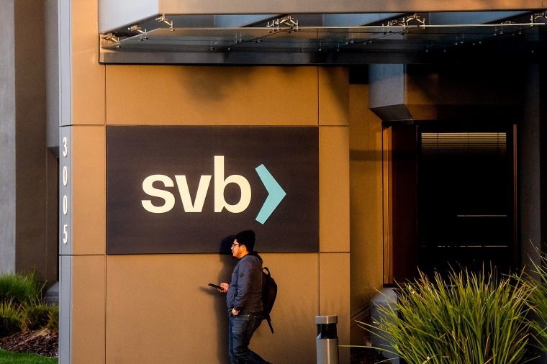
IS A BANKING CRISIS BEGINNING?
ORIGIN
WHY WORRY
WHAT’S BEEN DONE
HOW BIG A PROBLEM

Slide 27

THE LONG RUN OUTLOOK
NORTH CAROLINA CONTINUES TO GROW AND TRANSFORM
TECH ADVANCEMENTS AND OTHER CHANGES WILL MEAN SUBSTANTIAL “OCCUPATIONAL CHURNING”
SOME OCCUPATIONS WILL DOWNSIDE OR DISAPPEAR, WHILE OTHERS WILL EXPAND OR BE CREATED

Slide 28

IMPLICATIONS FOR NC COMMUNITY COLLEGES
NEEDED “NOW MORE THAN EVER”
BOTH TRAINING AND RE-TRAINING NEEDED – OFTEN QUICKLY
COMMUMITY COLLEGES’ CLOSE WORK WITH THE NEEDS OF BUSINESSES WILL BE VITAL

