Slide 1
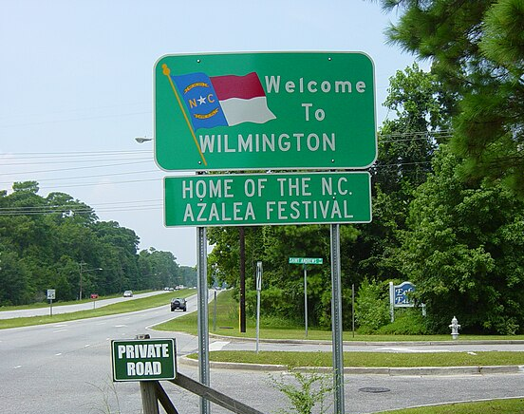
North Carolina Association of Community College Trustees
2023 Leadership Seminar
August 31, 2023
Hotel Ballast

Slide 2
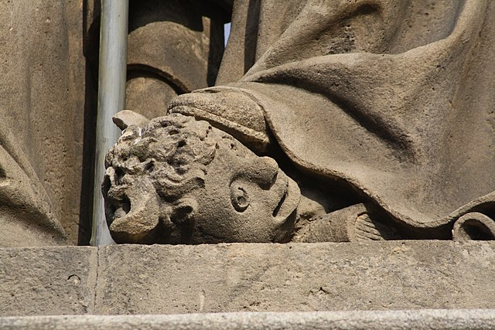
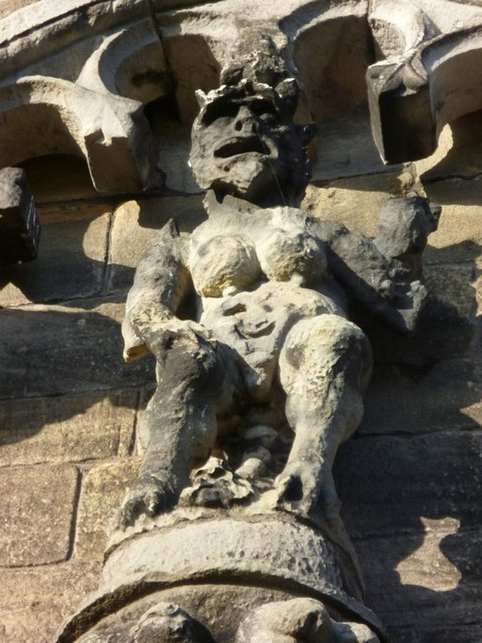
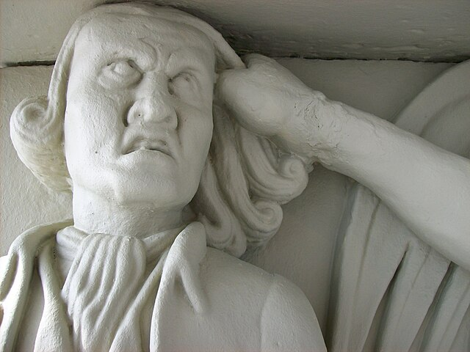
Community college employee benefits for
paid parental leave, freedom of speech, and
dignity in the workplace
Session Law 2023 - 14
Session Law 2023-62
Paid Parental Leave (NCGS § 126‑8.6)
Also amends Elementary & Secondary Education (NCGS § 115C)
Prohibit compelled speech (NCGS § 126‑14.5)
Dignity in State government workplaces (NCGS § 126‑14.5)
Notes:
I want to talk with you today about two Session Laws that amend the North Carolina Human Resources Act, which normally applies to employees of State agencies, but that also apply to community college employees.
two conversations earlier this week about this presentation.
expect questions, refer to the State Board Code and the Session Laws for clarification.
remind the trustees - governance role, be focused on the fact that your college has both leave and employment policies, and not an operational role, have hired qualified and dedicated faculty and staff who ensure that your college policies are implemented well..

Slide 3
Session Law 2023-14 Paid Parental Leave

Slide 4
S.L. 2023 - 14 PAID PARENTAL LEAVE FOR STATE EMPLOYEES
What does and does not apply to community colleges?
Notes:
Be aware, that not all of the provisions for Paid Parental Leave apply to community colleges.

Slide 5
S.L. 2023 - 14 PAID PARENTAL LEAVE FOR STATE EMPLOYEES
Section 5.1.(c)
Applies to public school teachers (amends G.S. § 115C‑302.1(j))
Allows teachers to use multiple types of leave with some distinctions for how the child joined the family.
Some local discretion for intermittent leave
Notes:
items that do NOT apply to community college employees.

Slide 6
S.L. 2023 - 14 PAID PARENTAL LEAVE FOR STATE EMPLOYEES
Section 5.1.(d)
Applies to school employees (amends G.S. § 115C‑336.1)
Allows school employees to use multiple types of leave with some distinctions for how the child joined the family.
Some local discretion for intermittent leave
Notes:
The same applies to non-teaching school employees in K-12, <
118 Cooperative Innovative High Schools that partner with our 58 community colleges.
employees of public schools and employees of community colleges talk with each other -- employees at your college may hear what leave their public school colleagues are taking.

Slide 7
S.L. 2023 - 14 PAID PARENTAL LEAVE FOR STATE EMPLOYEES
Section 5.1.(e)
Appropriation only to the Department of Public Instruction
For the 2023‑2024 fiscal year
For the 2024‑2025 fiscal year
Notes:
Bottom line for our purposes – Session Law 2023-14 does not appropriate funds for community colleges to cover the Paid Parental Leave

Slide 8
S.L. 2023 - 14 PAID PARENTAL LEAVE FOR STATE EMPLOYEES
Section 5.1.(b)
G.S. 126‑5 is amended by adding a new subsection to read:
"(c19) The provisions of G.S. 126‑8.6 shall apply to all exempt and nonexempt State employees in the executive branch; to public school employees; and to community college employees. The legislative and judicial branches shall adopt parental leave policies."
(emphasis in bold added)
Notes:
Let’s turn now to what IS included in Session Law 2023-14.
The changes do not occur in Chapter 115D, they fall within Chapter 126, the North Carolina Human Resources Act, and explicitly call out that the provisions for Paid Parental Leave DO apply to community college employees.

Slide 9
S.L. 2023-14 PAID PARENTAL LEAVE Section 5.1.(a)
A few definitions:
Qualifying event. – When a State employee becomes a parent to a child.
§ 126‑8.6(a)(3)
Notes:
Qualifying Event to define what triggers the need to provide employees with Paid Parental Leave. Namely, that is when an employee becomes a parent to a child. The law uses the phrase Qualifying Event multiples times in the interests of statutory brevity and clarity.

Slide 10
PAID PARENTAL LEAVE
A few definitions:
Child. –
A newborn biological child
A newly placed adopted child under the age of 18
A newly placed foster child under the age of 18
An otherwise legally placed child under the age of 18
§ 126‑8.6(a)(1)

Slide 11
PAID PARENTAL LEAVE
A few definitions:
Parent. – Includes
A parent by adoption
A parent by foster care
A parent by another legal placement
§ 126‑8.6(a)(2)

Slide 12
PAID PARENTAL LEAVE 1C SBCCC 200.100
“Parent” means:
the mother or father of a child through birth or legal adoption; or
an individual who cares for a Child through foster or other legal placement under the direction of a government authority.
For state employees:
25 NCAC 01E .1901 3(a)
For community college employees:
1C SBCCC 200.100
Notes:
As required by the Session Law, the Office of State Human Resources (OSHR) implements paid parental leave in its codes, and the State Board of Community Colleges has implemented Code that is "substantially equivalent" to that promulgated by OSHR. Your college policy should also be "substantially equivalent" as required.
The administrative code implementing the statute addresses the ambiguous definition of parent in the session law.
The statutory definition includes three ways to become a parent.
The NC Administrative Code and the State Board of Community College code also include the mother or father of a child through birth.
~ these are the parents whose names are entered on the child's birth certificate.
other situations in which someone is granted guardianship or other legal custody of a child.
documentation of legal placement under the direction of a government authority.
The administrative code uses the phrasing "under the direction of a government authority" to be clear about what is meant by legal placement.

Slide 13
PAID PARENTAL LEAVE
Q: What leave is required for permanent full-time employees?
A: Parent who gives birth to a Child:
up to eight weeks of paid leave
Other Parents:
up to four weeks of paid leave after any other Qualifying Event.
§ 126‑8.6(b)(1) and (2)
Notes:
What actually is the leave that is required?
Women who are permanent full-time community college employees and have given birth must receive up to 8 weeks of paid leave.
four weeks of medical-related recovery time and four weeks of child-bonding time.
What happens for a woman whose pregnancy ends with a still birth or the birth of a child whose survival is brief?
Other permanent full-time community college employees do not have medical-related recovery needs but must receive up to 4 weeks of paid leave after becoming parents
In addition, the State Board of Community College has set in its temporary rules to require for eligibility at the time of a qualifying event that the employee has been employed without a break in service for the immediate 12 preceding months; and to have been in pay status for at least 1,040 hours during the previous 12-month period.

Slide 14
PAID PARENTAL LEAVE
Q: What leave is required for permanent part-time employees, in addition to any other leave available to the employee?
A: Parent who gives birth to a Child:
Prorated not to exceed four weeks of paid leave
Other Parents:
Prorated not to exceed two weeks of paid leave after any other Qualifying Event.
§ 126‑8.6(c)
Notes:
The leave time for permanent part-time employees is halved and provided in addition to any other leave available to the permanent part-time employee. The same eligibility requirements are in place in State Board code.
Leave for mothers who give birth is not to exceed four weeks.
Leave for parents through other Qualifying Events is not to exceed two weeks.

Slide 15
PAID PARENTAL LEAVE
Q: What leave is required for temporary employees?
A: None. Session Law 2023-14 is silent, and the State Board of Community College Code states that temporary employees are not eligible.

Slide 16
PAID PARENTAL LEAVE
Q: Can employees use paid parental leave intermittently?
A: Yes.
1C SBCCC 200.100(g)
Notes:
Employees may take Paid Parental Leave in one continuous period or use it intermittently.
Colleges cannot dictate how mothers who give birth decide to use their paid parental leave.
For other employees, the college may delay leave or provide it intermittently if providing the leave causes a public safety concern – in general, a combination of maintaining operational safety or protecting health and safety when supplemental staffing is not available.

Slide 17
PAID PARENTAL LEAVE
Q: My college employs two individuals who are becoming Parents of the same Child. What do I do?
A: “If both Parents are eligible employees, each may receive Paid Parental Leave.”
1C SBCCC 200.100(g)(7)
Notes:
The State Board Code also says that “Both eligible employees may take Paid Parental Leave at the same time or at different times, pending no Public Safety Concern.” One or both may be taking the leave intermittently. Your college will need to provide coverage for job responsibilities for both while they are on leave.

Slide 18
PAID PARENTAL LEAVE
Q: Do employees who use paid parental leave have to exhaust other sick or vacation leave they may have accrued?
A: No.
§ 126‑8.6(d)(1)
Notes:
The employee's sick leave and vacation leave balances remain undisturbed when they claim Paid Parental Leave time.

Slide 19
PAID PARENTAL LEAVE
Paid parental leave
Is awarded in addition to shared leave under G.S. 126‑8.3
§ 126‑8.6(d)(1)
Notes:
Permanent employees, who do not have accrued sick or vacation time otherwise, do not need to request shared leave to claim Paid Parental Leave.

Slide 20
PAID PARENTAL LEAVE
Q: We have an employee who is a foster parent. They had a child placed for a short time in July. They expect to have another child placed soon.
A: Paid parental leave may be used only once for a Qualifying Event within a 12 month period.
1C SBCCC 200.100(h)(1)
Notes:
Likewise, having a multiple birth, adoption of siblings or other legal placement of more than one child does not increase the amount of Paid Parental Leave for that event.

Slide 21
PAID PARENTAL LEAVE
Paid parental leave
Is awarded in addition to other leave authorized by State or federal law.
§ 126‑8.6(d)(1)
Notes:
a hypothetical: An employee has used all 12 weeks of their Family Medical Leave allotment when a qualifying Event occurs. They remain eligible during that 12 month FML time period to take the full amount of paid parental leave.
hypothetical. A permanent full-time employee took her full amount of Paid Parental Leave. As long as she qualifies otherwise for Family Medical Leave, she remains eligible to take the full amount, 12 weeks, of FML in addition to the 8 weeks of Paid Parental Leave she took earlier in the year. She would need to satisfy the FMLA requirements, but having taken Paid Parental Leave does not make her ineligible.

Slide 22
PAID PARENTAL LEAVE
Paid parental leave
Has no cash value upon termination from employment.
§ 126‑8.6(d)(2)
Notes:
A few final notes, the paid parental leave is not paid out to the employee if they terminate employment.

Slide 23
PAID PARENTAL LEAVE
Paid parental leave
May not be used for calculating an employee's retirement benefits.
§ 126‑8.6(d)(3)
Notes:
Employees interested in this leave should consider that the time that elapses during paid parental leave does not count toward the employee's retirement benefits. Your HR and payroll offices have a separate leave code to apply to Paid Parental Leave so that TSERS can accurately account for this time.

Slide 24
PAID PARENTAL LEAVE
Section 5.1.(f)
"This Part becomes effective July 1, 2023, and applies to requests for paid parental leave related to births occurring on or after that date."(emphasis in bold added)
The relevant administrative code is effective July 1, 2023, and describes eligibility for leave in terms of the documented Qualifying Event.
Notes:
For those who may be curious about further implementation, the Office of State Human Resources has a handy fillable form available online.

Slide 25
Session Law 2023-62 Prohibit compelled speech Ensure dignity and nondiscrimination
Notes:
.

Slide 26
S.L. 2023 - 62
What does and does not apply to community colleges?
Notes:
All of this Session Law applies to community college employment, employees, and workplaces.

Slide 27
S.L. 2023 - 62
Part i. Prohibit state government from compelling certain forms of employee speech
Part II. Dignity in state government workplaces
Part iii. miscellaneous

Slide 28
S.L. 2023-62 Part I Compelled speech prohibited
Each … institution shall … refrain from soliciting or requiring an applicant for employment
To endorse or opine about beliefs, affiliations, ideals, or principles regarding matters of contemporary political debate or social action as a condition of employment.
To describe the applicant's actions in support of, or in opposition to, these beliefs, affiliations, ideals, or principles
§ 126‑14.5(a)(1)
§ 126‑14.5(a)(2)
Notes:
Part 1addresses applicants for employment.
amends the North Carolina Human Resource Act but is made applicable to all community college employees.
recognize this language from changes made earlier in the year by the UNC System

Slide 29
S.L. 2023-62 Part I Compelled speech prohibited
Q: What if an applicant starts talking about something that we cannot ask?
A: They may.
“Nothing in subsection (a) shall infringe on the ability of an applicant for employment to voluntarily opine or speak regarding any matter, including matters of contemporary political debate or social action.”
§ 126‑14.5(b)
Notes:
We as community college employers cannot ask about these things.
We have policy guidance from the people of North Carolina acting through the General Assembly advising that we refrain from compelling an applicant's speech as a condition of employment.

Slide 30
S.L. 2023-62 Part I Compelled speech prohibited
Q: What about the college’s application for employment?
A: Do not ask on the application what you cannot solicit or require of an applicant directly.
§ 126‑14.5(c)

Slide 31
S.L. 2023-62 Part I Compelled speech prohibited
Q: What about the written materials an applicant submits or oral remarks from an applicant?
A: You can discuss these with the applicant.
§ 126‑14.5(d)(1)
Notes:
policy guidance for the interview when an applicant has volunteered an opinion or speaks about these matters.
resume’, a curriculum vitae, or other written materials from the application. You can talk with and ask questions of the applicant regarding the content of these items.
applicant has the freedom to express themselves. Nothing in the section prohibiting compelled speech shall be construed to prohibit your discussion with or questions to an applicant regarding what they volunteer in written work or oral remarks.
You cannot ask about these things, but they can volunteer. The applicant initiates these conversations, if they wish and at their discretion.

Slide 32
S.L. 2023-62 Part I Compelled speech prohibited
Q: What if there are federal or State laws, such as employment oaths, appointment affidavits, and licensure or certification requirements?
A: “Nothing in this section shall be construed to … affect the ability of [a college] from complying.”
§ 126‑14.5(d)(2)

Slide 33
S.L. 2023 – 62 Part II. Dignity in state government workplaces
This part begins with a legislative finding and a statement of intent:
“The General Assembly finds that Article I, Section 1 of the Constitution of this State recognizes the equality and rights of all persons.”
“Therefore, it is the intent of the General Assembly that State employees
respect the dignity of others,
acknowledge the right of others to express differing opinions, and the right to freedom of speech and association and
that State agencies employ training methods and procedures to further that intent.”
§ 126‑14.6(a)
Notes:
Part II discusses your employees, either current ones or the new ones after hiring.

Slide 34
S.L. 2023 – 62 Part II. Dignity in state government workplaces
Employees may not be compelled to affirm or profess belief in 13 enumerated concepts.
These concepts shall not be promoted in State government workplaces or included as part of any State employee training program.
§ 126‑14.6(b) and (c)
Notes:
where the Session Law says “State Employees,” “State government workplaces” or “State employee training programs” the law applies to community colleges.

Slide 35
S.L. 2023 – 62 Part II. Dignity in state government workplaces
One race or sex is inherently superior to another race or sex.
An individual, solely by virtue of his or her race or sex, is inherently racist, sexist, or oppressive.
An individual should be discriminated against or receive adverse treatment solely or partly because of his or her race or sex.
An individual's moral character is necessarily determined by his or her race or sex.
An individual, solely by virtue of his or her race or sex, bears responsibility for actions committed in the past by other members of the same race or sex.
Any individual, solely by virtue of his or her race or sex, should feel discomfort, guilt, anguish, or any other form of psychological distress.
A meritocracy is inherently racist or sexist.
The United States was created by members of a particular race or sex for the purpose of oppressing members of another race or sex.
The United States government should be violently overthrown.
Particular character traits, values, moral or ethical codes, privileges, or beliefs should be ascribed to a race or sex or to an individual because of the individual's race or sex.
The rule of law does not exist, but instead is a series of power relationships and struggles among racial or other groups.
All Americans are not created equal and are not endowed by their Creator with certain unalienable rights, including life, liberty, and the pursuit of happiness.
Governments should deny to any person within the government's jurisdiction the equal protection of the law.
Notes:
each of these 13 concepts “shall not be promoted in” your community college’s workplaces “or included as part of any” employee training program at your community colleges.

Slide 36
S.L. 2023-62 Part II Dignity in state government workplaces
Q: Sometimes my college brings outside speakers to campus. Do I need to worry about what they say?
A: Yes and no. Private contractors should not include these concepts in training they provide for your institution.
They can respond to questions from training participants that pertain to these concepts.
“However, the private contractor must make it clear that the State government employer does not endorse those concepts.”
§ 126‑14.6(d)

Slide 37
S.L. 2023-62
Q: What about protected speech?
A: Both Part I and Part II do not apply “to speech protected by the First Amendment of the U.S. Constitution.”
§ 126‑14.5(d)(3)
§ 126‑14.6(e)

Slide 38
S.L. 2023 – 62 Part III. Miscellaneous
Savings clause.
Section 3.(a)
This act is effective December 1, 2023.
Section 3.(b)
Notes:
savings clause – any section or provision of the Session Law that is declared unconstitutional or invalid is severable. Such a declaration does not affect the validity of the act as a whole or any part that was not declared to be unconstitutional or invalid.
effective December first of this year.

