Slide 1
Strengthening Colleges
Through
Strategic Academic Partnerships
Bladen Community College: Dr Mandi Lee
Fayetteville Technical Community College: Dr. Mark Sorrells
Richmond Community College: Dr. Dale McInnis

Slide 2
Background
Our 58 Colleges ranged in curriculum enrollment in 2022 from 543 to 21,454.
Each College has built programs to align with the economic and workforce needs of its communities.
The labor market and employer needs are shifting rapidly as our state has become the #1 destination in the country for economic development. This requires our Colleges to be more flexible and agile.
Leadership in the General Assembly has recently promoted increased regional collaboration among the Great 58.

Slide 3
The Challenge
With limited resources and defined service areas, how can all of our 58 colleges adapt to meet the rapidly evolving workforce and economic development needs?

Slide 4
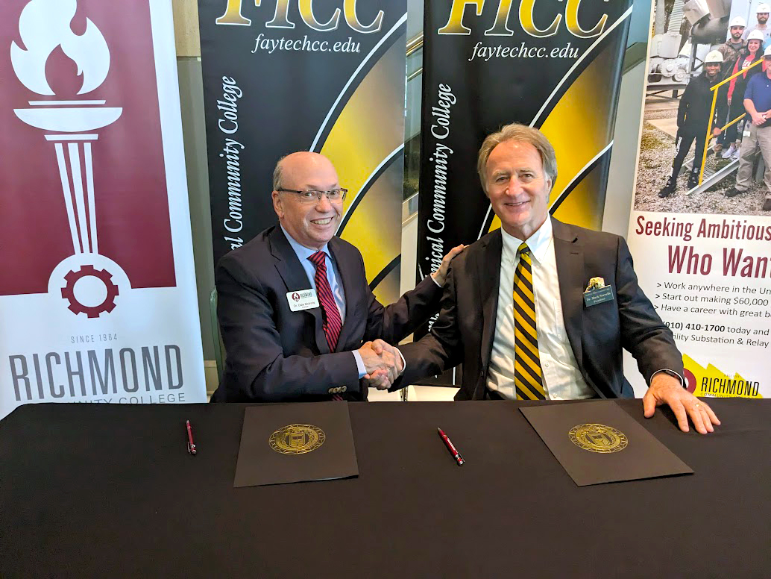
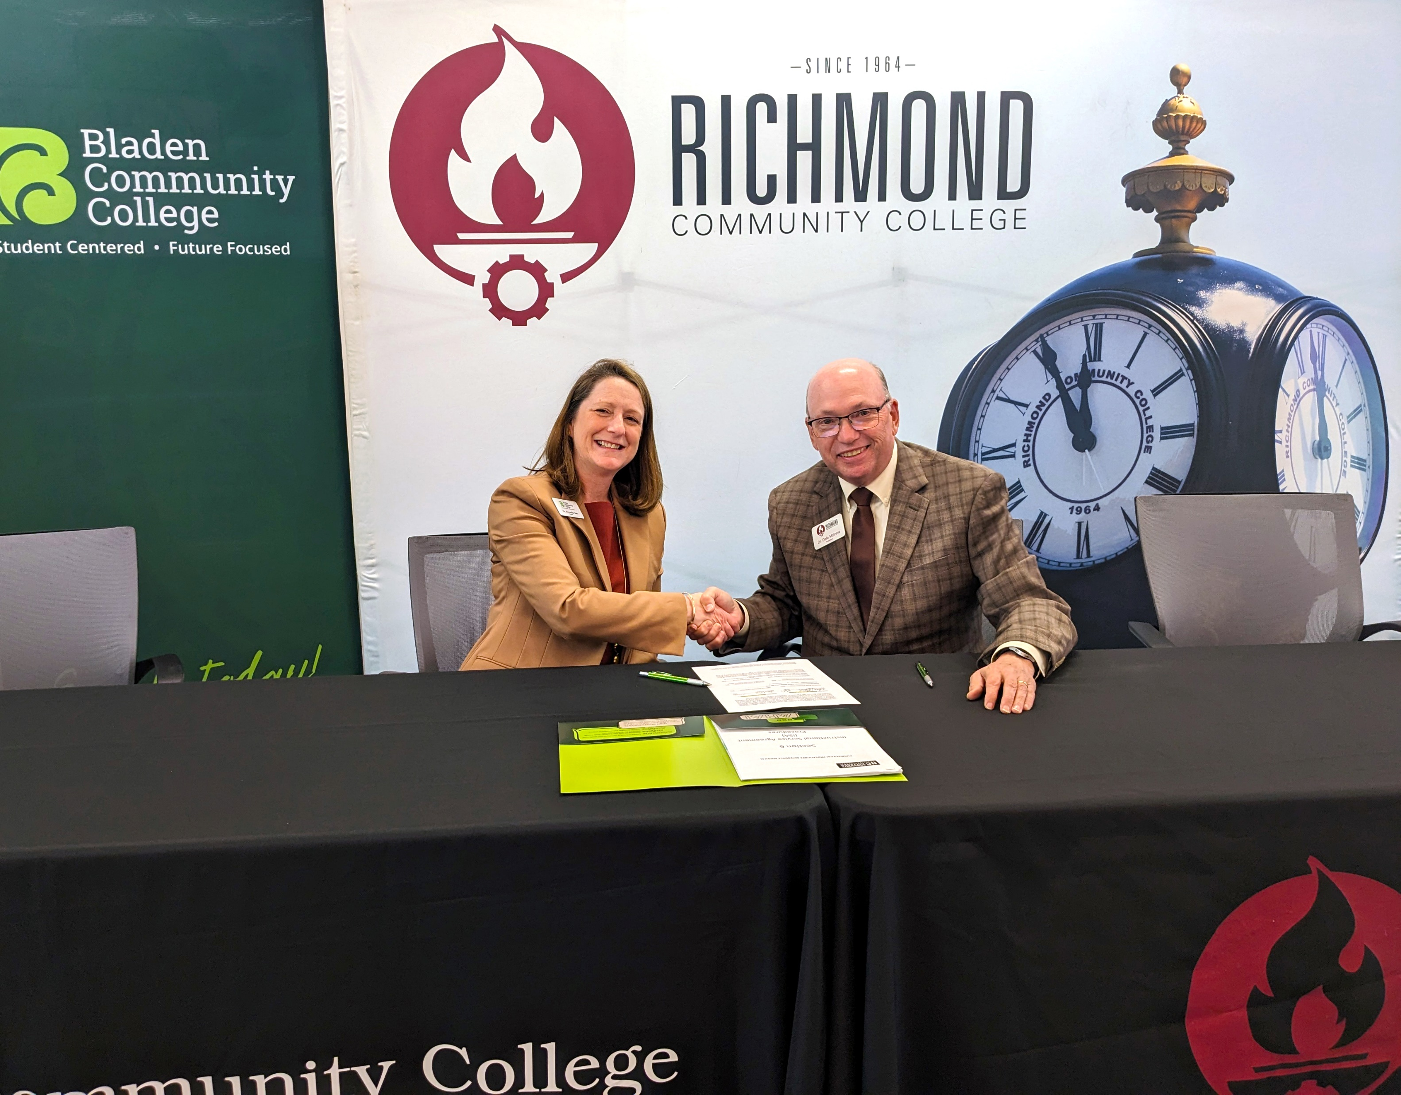
Our Solution, Our Story
Strategic Regional Partnerships:
Expand options for Colleges and students
Avoid duplicative programs
Provide better utilization of scarce resources

Slide 5
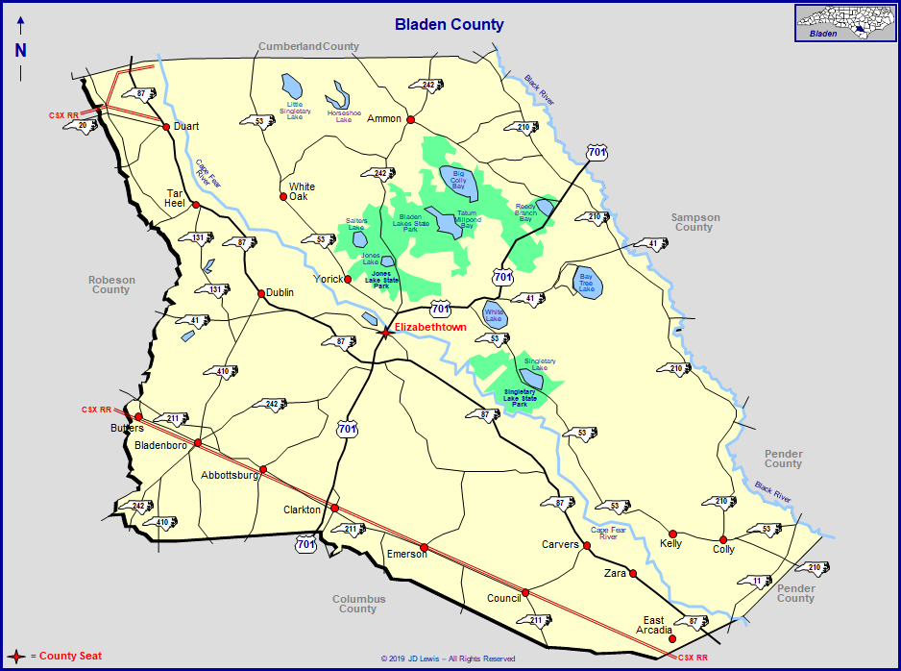
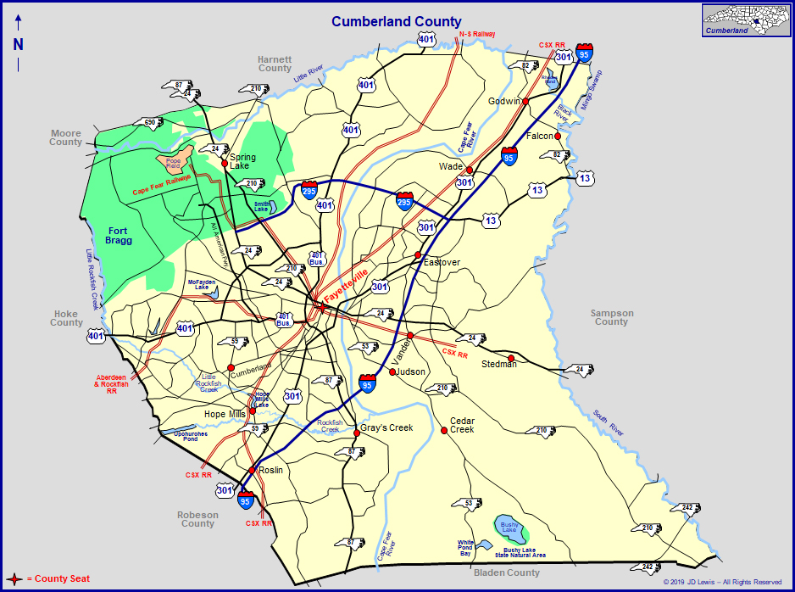
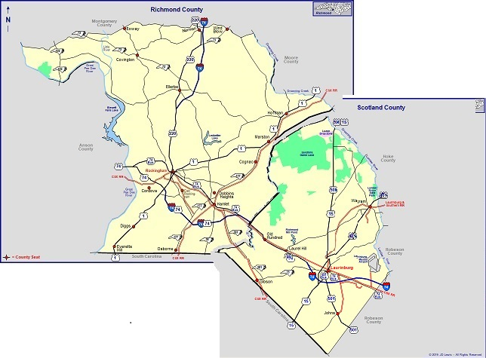
Our Solution, Our Story
Entrepreneurial approach
Determines how a large urban College, a medium multi-county College and a small rural College can strategically collaborate to leverage their strengths and magnify student opportunities

Slide 6
The Colleges
Bladen Community College
Serves Bladen County, population 29,402
1,265 FTE, 3,014 total students in 2022-23
Dr. Mandi Lee, President since 2019
Fayetteville Technical Community College
Serves Cumberland County, population 336,699
12,694 FTE, 29,755 total students in 2022-23
Dr. Mark Sorrells, President since 2023
Richmond Community College
Serves Richmond & Scotland counties, population 75,814
2,728 FTE, 8,076 total students in 2022-23
Dr. Dale McInnis, President since 2010

Slide 7
Instructional Service Agreements (ISAs)
Three levels of ISAs – all require Board of Trustee approval
Level 1: No sharing of revenue, FTE or costs. Allows one College to teach within another’s service area.
Level 2: Sharing of revenue and FTE for curriculum or continuing education courses. Requires System Office notification.
Level 3: Sharing of revenue and FTE for curriculum or continuing education programs. Requires System Office approval.

Slide 8
The Partnerships
Bladen CC and FTCC
Commercial Driver’s License – shared use of driving pad and joint grant applications
Physical Therapy Assistant AAS Degree
Accounting AAS Degree
Hospitality Management AAS Degree
FTCC and Richmond CC
Paralegal AAS Degree
Speech Language Pathology AAS Degree
Respiratory Therapy AAS Degree
Funeral Service AAS Degree
Electric Utility: Substation and Relay AAS Degree
Richmond CC and Bladen CC
911 Telecommunications and Operations AAS Degree

Slide 9
Partnerships With Other Colleges
FTCC
Robeson Community College: Funeral Service, Dental Assisting, Dental Hygiene
Carolina Cyber Network: FTCC is co-lead and founder of this consortium of 18 two-year and four-year Colleges in NC
Richmond CC
Montgomery Community College: CDL Training
911 Telecommunications & Operations:
Caldwell Community College & Technical Institute
Gaston College
Stanly Community College
Four other Colleges in the works

Slide 10
Advantages of Academic Partnerships
Reduces risks and costs of program start-up
Supports employers with limited job demand
Improved efficiency, cost savings for students
Optimizes institutional strengths in programs, staff and facilities
Students can take more courses at their local College
Shared marketing and branding expands visibility for everyone

Slide 11
Barriers to Building Academic Partnerships
Lack of incentives to partner and build ISAs
Program prerequisites and corequisites
Aligning schedules
Advising and marketing
Geography and proximity
Getting past “We have always done it this way!”
Communication between college administrators and faculty
One-size-fits-all mentality

Slide 12
System Level Opportunities
Improve tracking and reporting of academic partnerships, showcasing best practices
Promote and incentivize regionalism and flexibility to encourage and reward innovation and collaboration
Identify and pursue entrepreneurial ideas to diversify revenue streams available to community colleges
Dedicated funding opportunities for pilot, start-up programs
Examine State Codes for opportunities to support new business models and innovative practices

Slide 13
Advice for Building Future Partnerships
Start with positive, trusting relationships between the Presidents.
Make sure support staff understand and can deliver a consistent message that explains why the partnership makes sense for the students, communities and institutions.
Make sure the local Board understands the ISA and how it supports the college’s mission and autonomy.
These partnerships involve academic programs only. Shared administrative services are much more complicated and require detailed planning.
We are not sharing personnel; this would add complications that require careful planning and coordinated management.
Do collective cost/benefit analysis and renegotiate the terms in the partnership agreements at least annually.
Celebrate the partnership and promote as if it were another program.
Move beyond the status quo and be creative with your partners.

Slide 14
One Last Item…
Thank you for your attention today!
Any questions?

