Slide 1
NCACCT General Session - Tabletop Discussion Assignments
COLLEGE | TABLE
A-B Tech | 33
Alamance | 24
Beaufort County | 3
Bladen | 9
Blue Ridge | 33
Brunswick | 8
Caldwell | 35
Cape Fear | 5
Carteret | 4
Central Carolina | 14
Central Piedmont | 34
Cleveland | 34
Coastal Carolina | 6
College of The Albemarle | 1
COLLEGE | TABLE(S)
Craven | 6
Davidson-Davie | 25
Durham Technical | 17
Edgecombe | 20
Fayetteville Technical | 10
Forsyth Technical | 25 & 26
Gaston | 37 & 38
Guilford Technical | 24
Halifax | 2
Haywood | 31
Isothermal | 31
James Sprunt | 7
Johnston | 16
Lenoir | 6
COLLEGE | TABLE(S)
Martin | 42
McDowell Tech | 33
Mitchell | 39
Montgomery | 11
Nash | 15
Pamlico | 4
Piedmont | 22
Pitt | 3
Randolph | 23
Richmond | 10
Roanoke-Chowan | 1
Robeson | 10
Rockingham | 27 & 28
Rowan-Cabarrus | 39
COLLEGE | TABLE(S)
Sampson | 12
Sandhills | 13
South Piedmont | 40
Southeastern | 8
Southwestern | 32
Stanly | 41
Surry | 29 & 30
Tri-County | 32
Vance-Granville | 18 & 19
Wake Tech | 21
Wayne | 7
Western Piedmont | 36 & 37
Wilson | 20
NCCCS | TABLE
Tawanda Foster Artis | 9
Dr. Shirley Carraway | 14
Dr. Jeff Cox | 21
Lisa Estep | 8
Alex Fagg | 15
Dr. Kimberly Gold | 13
Nathan Hardin | 17
Jon Harris | 38
Sondra Jarvis | 23
Tom Looney | 21
John Loyack | 1
Anthony Pile | 4
Ray Trapp | 17

Slide 2
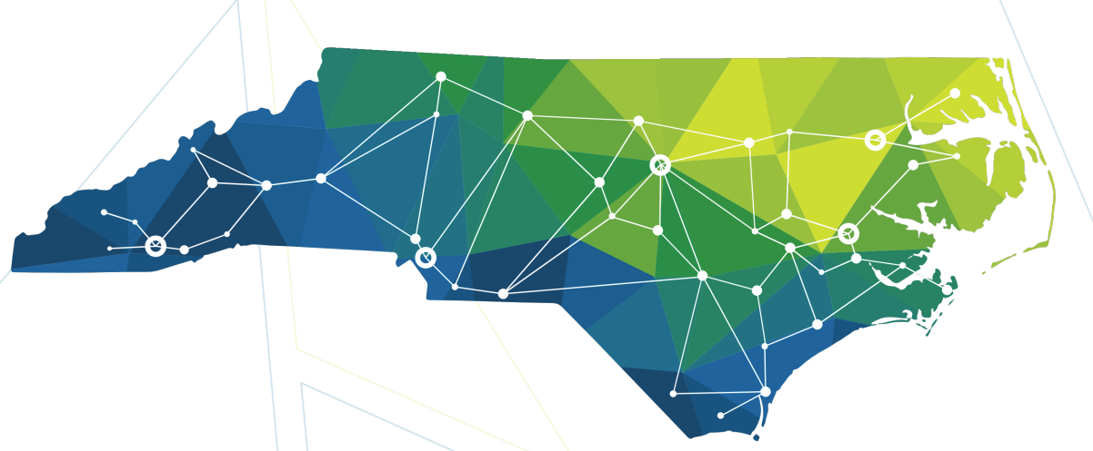
NCACCT Leadership Seminar
August 31, 2023

Slide 3
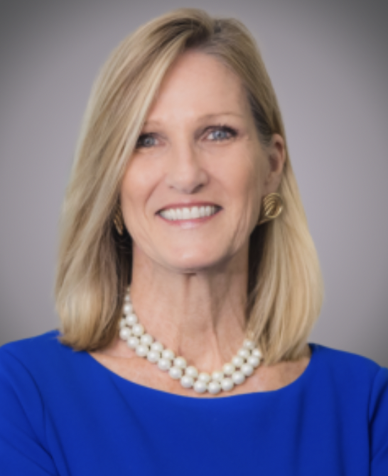
Cecilia Holden
myFutureNC
President & CEO
Notes:
Slide with photo, title, and name for each presenter

Slide 4
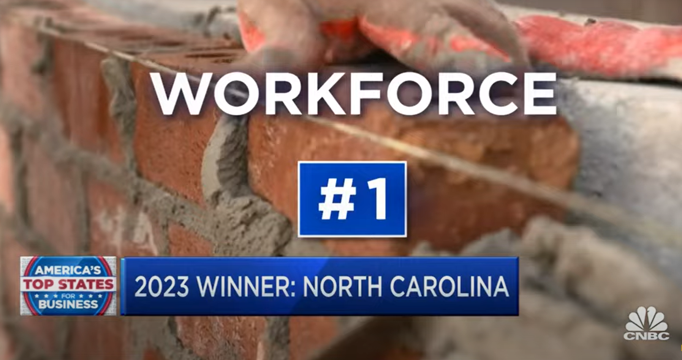
NC RANKED #1 WORKFORCE in 2023- AGAIN!
(This is) the result of statewide collaboration, partnership, and hard work by our economic development community, including but not limited to:
myFutureNC
North Carolina Community College System
North Carolina Regional Councils of Governments
North Carolina’s 20 Local Workforce Development Boards
North Carolina’s 100 Counties
North Carolina’s 552 Municipalities
The University of North Carolina System
–Statement from Commerce Secretary Machelle Baker Sanders (LINK)

Slide 5
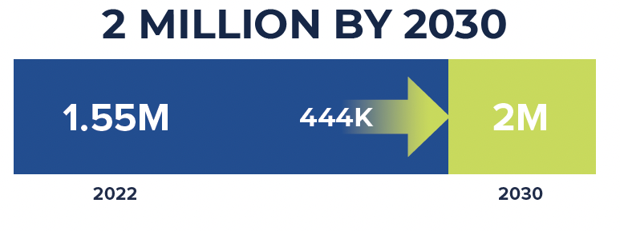
OUR GOAL - HOUSE BILL 664
To ensure North Carolina remains economically competitive now and into the future, we must meet the state’s educational attainment goal – to have 2 million North Carolinians aged 25-44 hold an industry-valued credential or postsecondary degree by 2030.

Slide 6
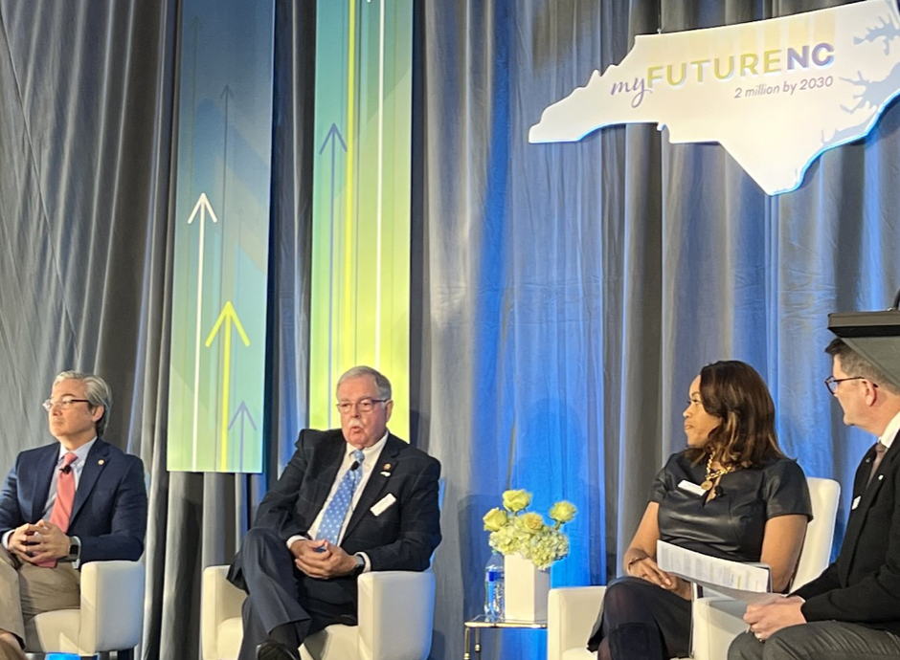
myFutureNC LEADERSHIP
myFutureNC Leadership
Board of Directors
John A. Fraley, Chair
Lynn Good, Vice-Chair
MC Belk Pilon, Secretary and Treasurer
Deanna Ballard
Kathryn Black
Marshall Cherry
Dr. Jeff Cox
John F.A.V. Cecil
Geoff Coltrane
Eric C. Davis
Ann Goodnight
Peter Hans
Kevin Howell
Rep. Donny Lambeth
Senator Michael Lee
David Mounts Gonzales
Anna Spangler Nelson
Gary Salamido
Machelle Baker Sanders
Catherine Truitt
Dr. A. Hope Williams
Governed by a cross-sector board of directors comprised of NC education sector heads, policymakers, philanthropists, and business leaders. Additionally, the myFutureNC Advisory Board of Commissioners includes 60 individuals representing 36 North Carolina counties.
Advisory Board of Commissioners Community College Presidents
Dr. Lisa Chapman
Dr. Kandi Deitemeyer
Dr. Jason Hurst
Dr. Laura Leatherwood
Dr. Amanda Lee
Dr. Dale McInnis
Dr. Mark Poarch
Dr. Lawrence Rouse
Dr. David Shockley

Slide 7
AN OPPORTUNITY FOR ALL
To achieve our goal, myFutureNC will:
Monitor & Report Progress
Identify & Advocate for Policy Solutions
Accelerate Action
We believe a better educated North Carolina is the key to economic prosperity and upward mobility for all citizens.

Slide 8
Monitor & Report Progress

Slide 9
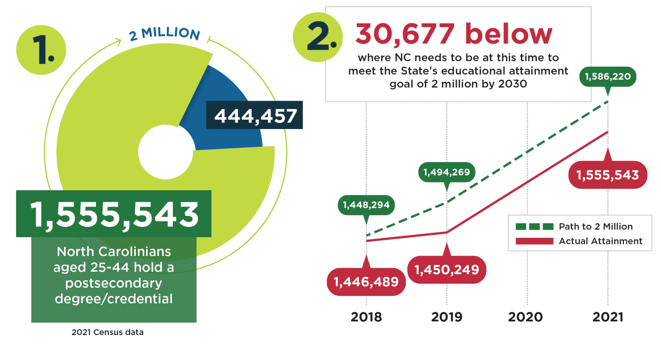
TRACKING TOWARDS 2 MILLION BY 2030

Slide 10
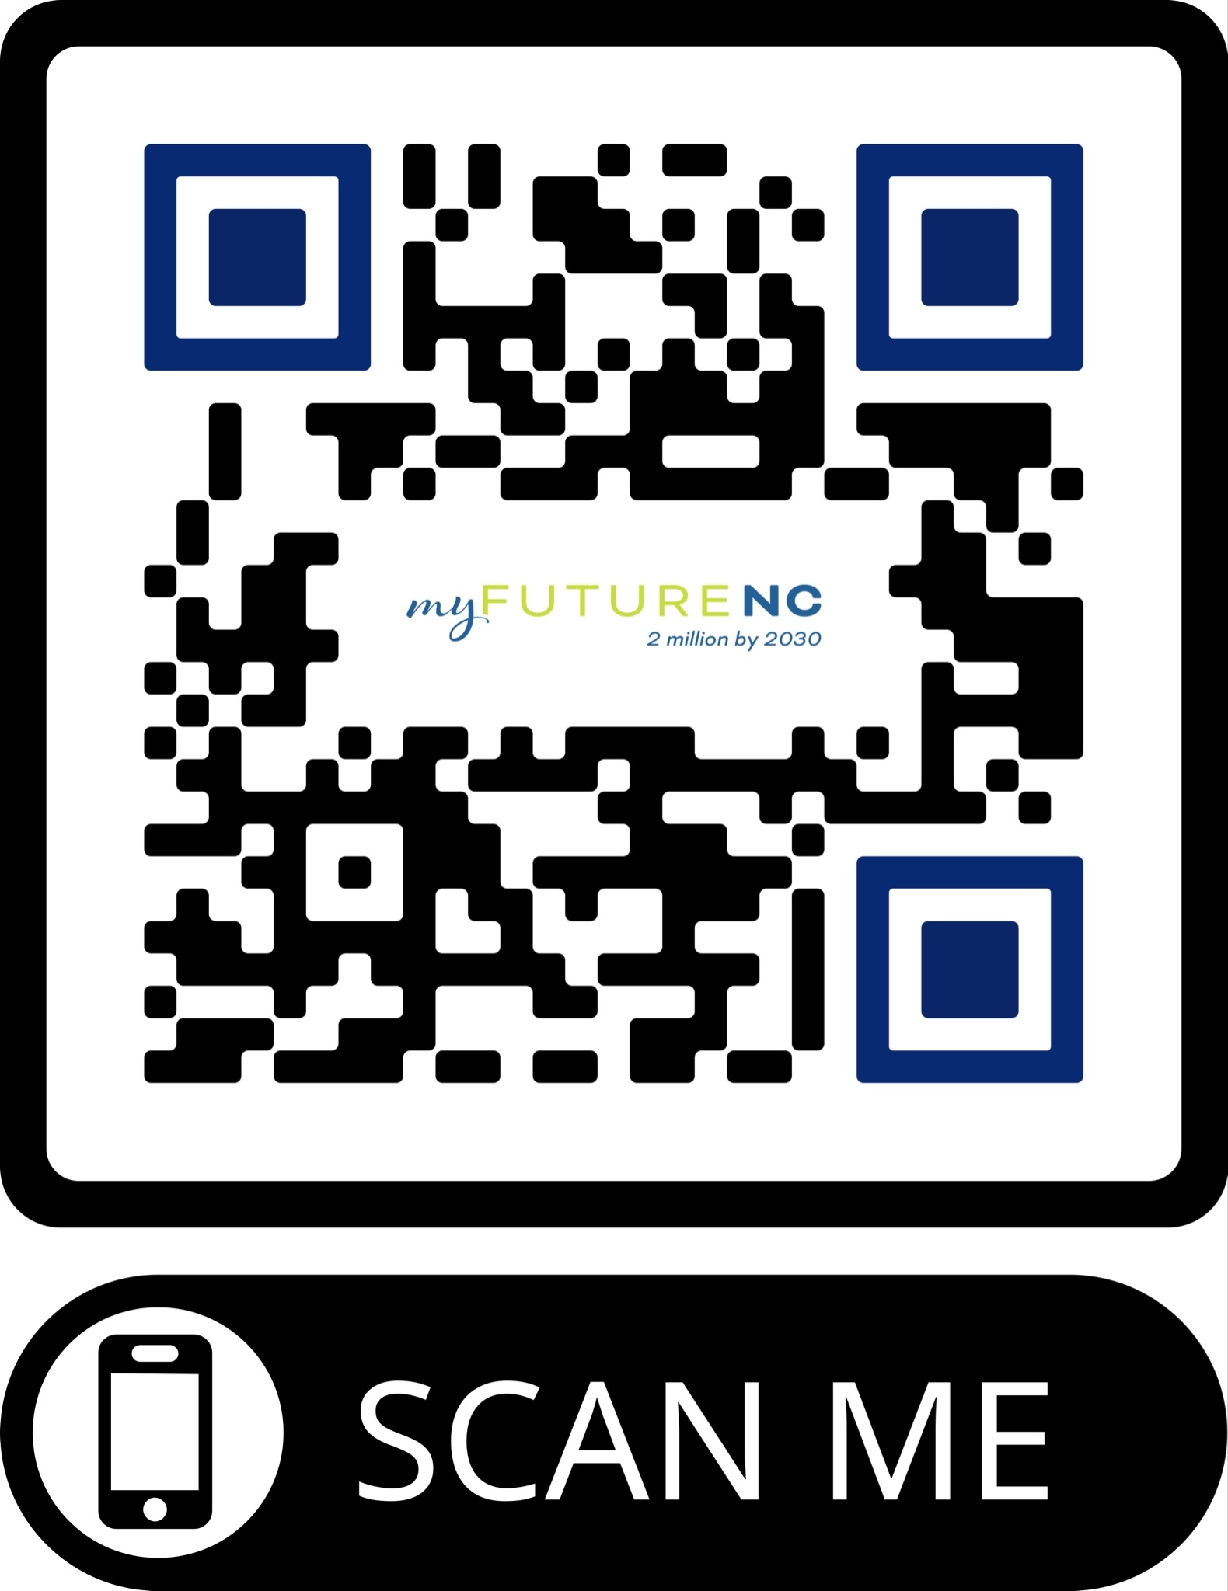
County Educational Attainment Rate Growth from 2018 to 2021
the share of population holding a postsecondary degree/credential
Notes:
Slide with photo, title, and name for each presenter

Slide 11
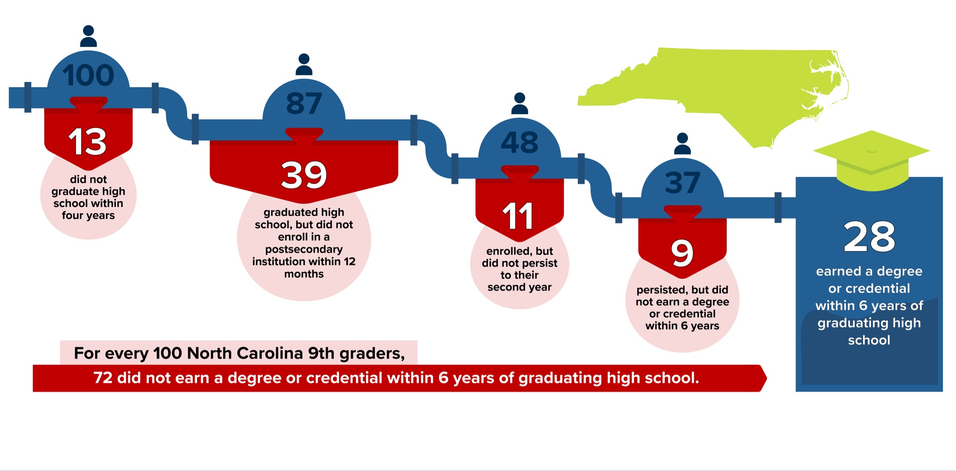
North Carolina’s LEAKY Education PIPELINE

Slide 12
On-Time Postsecondary Enrollment & Persistence: Key Efforts: FAFSA Pilots and Financial Aid Summit Why? Students who enroll in postsecondary immediately after high school graduation are more likely to stay in school and complete a degree.
Adult Learner Enrollment & Persistence: Key Efforts: NC Reconnect Why? For North Carolina to meet our 2 million by 2030 goal, we must engage and support more adults to start and/or return and finish postsecondary credentials that have industry value and are meaningful to the individuals.
Labor Market Alignment: Key Efforts: NC Workforce Credentials & HBCU-Business Convenings Why? In most regions of North Carolina, postsecondary degrees and credentials awarded are not sufficiently aligned with job opportunities in the area, limiting a graduate’s ability to earn a family-sustaining wage. While the state, overall, has a high rate of labor market alignment, most regions (14 out of 16) fall short of the state average.
Notes:
Slide with photo, title, and name for each presenter

Slide 13
IDENTIFY & ADVOCATE FOR POLICY SOLUTIONS

Slide 14
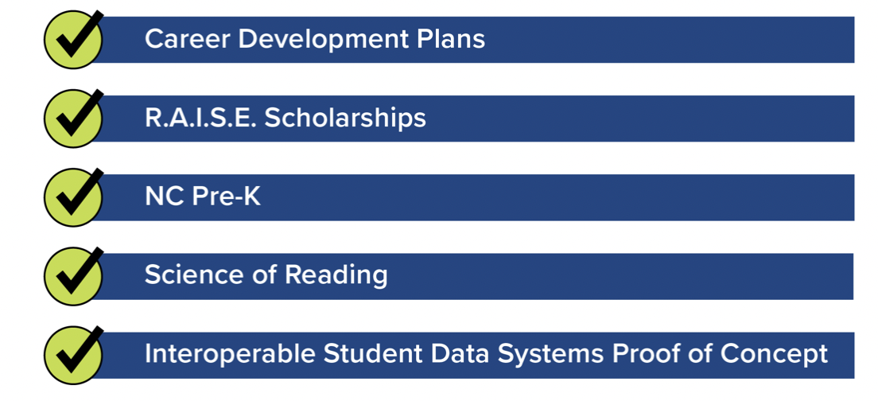
2023 PRIORITIES: Conference Budget Eligibility
Update: Raise the High School Dropout Age
Notes:
Slide with photo, title, and name for each presenter

Slide 15
Accelerate Action:
State Led but Locally Owned and Driven

Slide 16
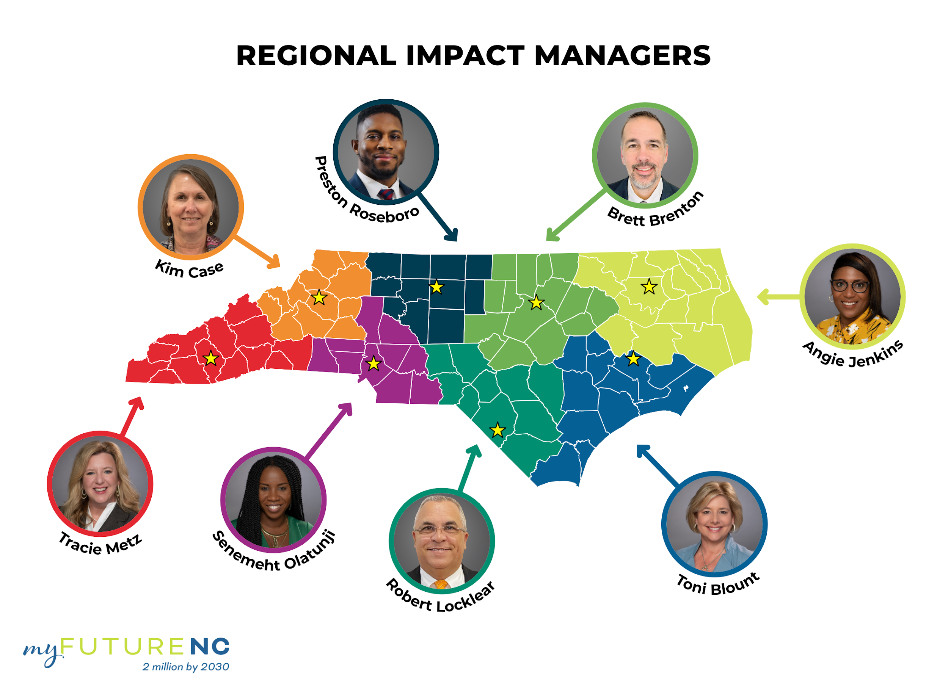
REGIONAL IMPACT MANAGERS

Slide 17
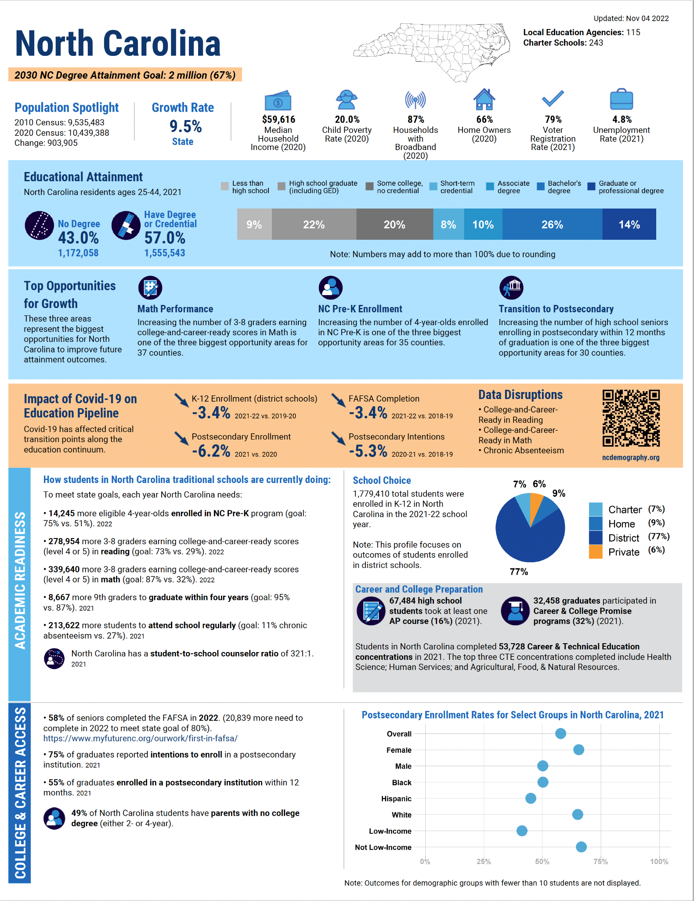
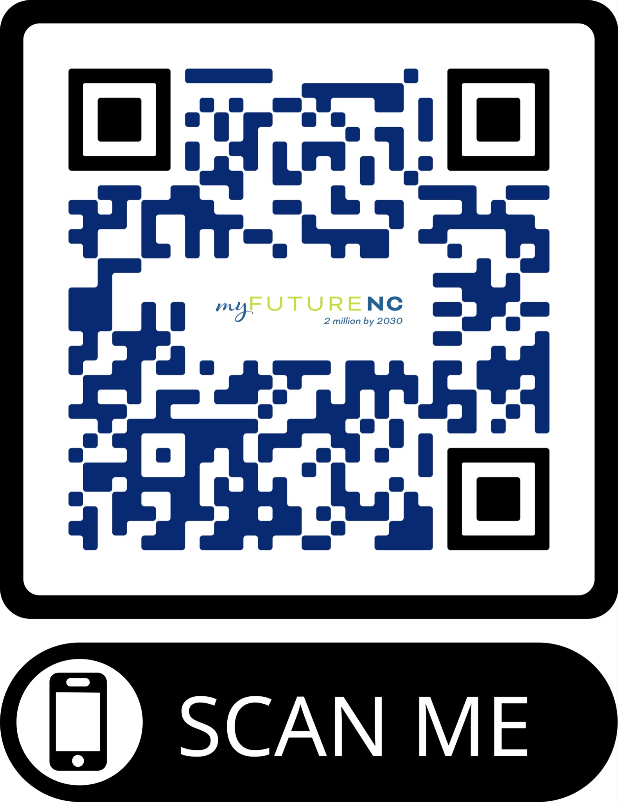
2022 COUNTY
ATTAINMENT PROFILES
100 Unique County Attainment Profiles
Local Performance on Key Indicators
Opportunities for Growth
Recommended Local Goals
WEB LINK
qrco.de/dataresources
Notes:
To equip our local leaders, we have a CAP for all 100 counties; FAFSA was one of the OfG

Slide 18
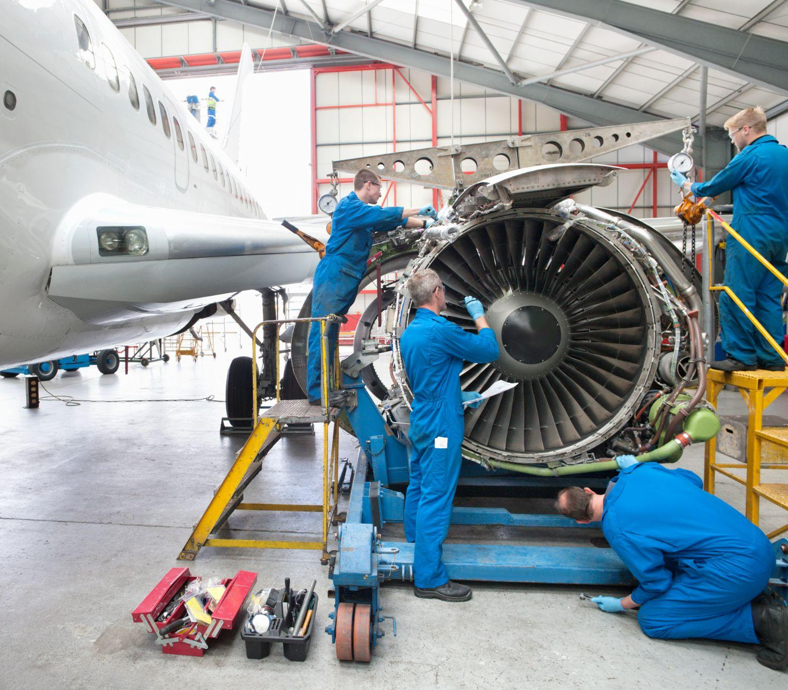
CONNECT CONVENE COMMUNICATE COLLABORATE COMMIT
Attainment-Focused
Workforce-Ready Communities
Endorse State Attainment Goal
Adopt Local Attainment Goal
Develop Local Attainment Action Plan
Execute Action Plan
Increase Local Attainment
Caldwell: Attainment-Focused Community
Adoption of State & Local Goals
County Commissioners; Board of Education; Community College | Board of Trustees (Caldwell & Watauga); Chamber of Commerce; Economic Development Advisory Committee; Cajah’s Mountain Town Council; Sawmills Town Council; Gamewell Town Council; Hudson Town Council; City of Lenoir; Village of Cedar Rock; Town of Granite Falls; Town of Rhodhiss)
Notes:
We recognize that many of your organizations have already adopted the 2 Million by 2030 state goal and we thank you for that. For those that have not, we would ask that you endorse the state goal alongside the local attainment goal. Regional Impact Managers will work with you to do that.

Slide 19
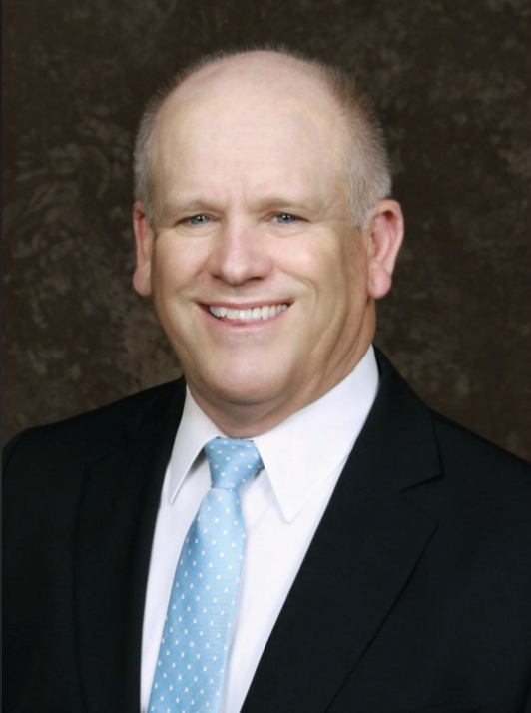
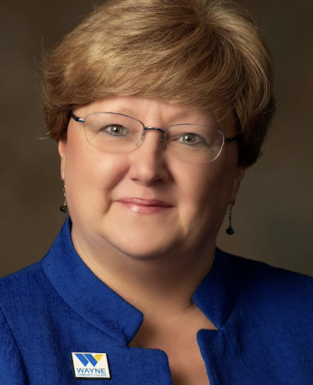
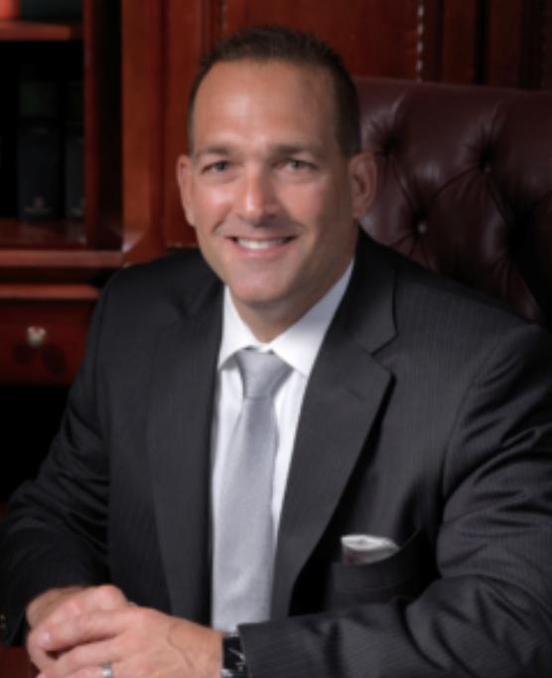
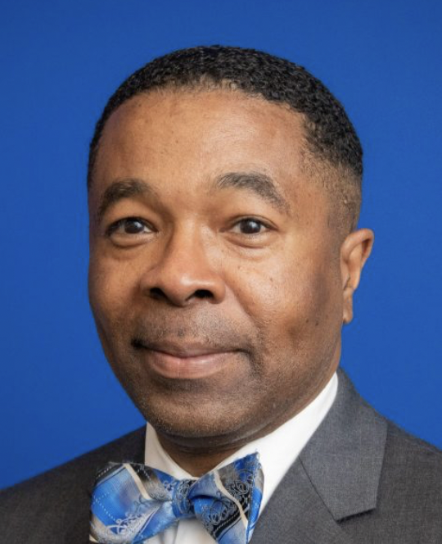
Wesley Beddard
Martin Community College President
Dr. Patty Pfeiffer
Wayne Community College President
Dr. Mark Poarch
Caldwell Community College & Technical Institute President
Dr. Derrick Wilkins
Martin Community College Board of Trustees Chair
Notes:
Slide with photo, title, and name for each presenter

Slide 21
Table Talk & Group Discussion
QUESTIONS FOR DISCUSSION
In reviewing your local county goal (top left of your county attainment profile), are you supportive of adopting a local educational attainment goal for the counties in your service area?
What are you already doing to help bring cross-sector partners to the table to assist you in increasing educational attainment in your district/college?
What role would you be willing to play, and would you be willing to take the lead to invite all cross-sector local partners together to encourage the full collective group to adopt the local goal and create a plan for addressing the opportunities for growth and other data points relevant to your individual county or regional needs?
In what ways could myFutureNC assist you in ongoing/future conversations with cross-sector partners?

Slide 22
CALL TO ACTION
Trustees work with Presidents to determine next steps:
Identify who might lead the local discussion around a local goal and attainment plan.
Invite community leaders for a conversation around increasing attainment.
Reach out to your myFutureNC Regional Impact Manager for support.
Keep doing the great things you are already doing, and don’t let what you can’t do get in the way of what you can do!
Save the Date - February 15, 2024: State of Educational Attainment in NC Event
Cecilia Holden, CEO and President
cecilia@myFutureNC.org

Slide 23
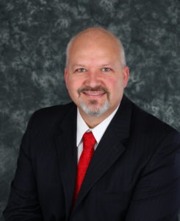
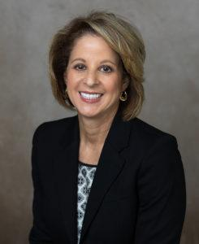
CALL TO ACTION
Wrap-Up
Dr. Jeff Cox
NCCCS President
myFutureNC Board of Directors
Dr. Laura Leatherwood
Blue Ridge Community College President
myFutureNC Advisory Board of Commissioners

