Slide 1
NCACCT Legal Seminar
Personnel Vignettes
March 14, 2024

Slide 2
Road Map
First Responder Programs
Disability Accommodations
Reduction in Force
Professional Development and
First Amendment Rights
COVID-19
Governance Changes

Slide 3
First Responder Programs

Slide 4
First Responder Programs
Whose program is it anyway
Claims of sexual harassment/discrimination
T&S Commission investigations

Slide 5
College Responsibility
Oversight, oversight, oversight – the program is the College’s responsibility and when something goes wrong, expect the licensing/ credentialing body to want to speak directly to the President.
Have a clear top-down approach regarding program expectations set by the President, down to instructors.
Regularly audit and set accountability standards
Create a culture where staff may report issues to the Director
When problems arise, whatever they may be – Be Proactive
Consider asking the State to come in and review the program
Take corrective measures before the state takes final action

Slide 6
First Responder Employees
Know who is coming onto your campus to "teach" for the College
Full-time instructors
Part-time instructors
One-off instructors
Role players and other independent contractors

Slide 7
First Responder Employees
Does everyone of these people understand the College’s expectations for professionalism, high academic standards, and appropriate personal conduct?
What training have they received?
Do they understand your College’s culture?
Side Bar – Do we have to pay them for the training?
Simply because the person works for
the local PD, EMS, or Fire Department
doesn’t mean they understand
the culture at your College.

Slide 8
First Responder Employees & Students
Chuck is a part-time instructor at Tarheel Community College. He also works full-time as a police officer for Mayberry PD.
Emma is a dispatcher for Mayberry PD. Her chief recommended she become a certified LEO and agreed to pay for her training at TCC.
Emma is in the break room at work with Chuck and some LEO’s who are giving Chuck a good ribbing. Emma laughs which embarrasses Chuck since he is one of her "teachers" at TCC.

Slide 9
Chuck and Emma
The following week, Chuck is teaching a class in which Emma is in attendance. Chuck retaliates against Emma by:
Requiring her to take additional physical training (PT)
Making her serve in a physical role-playing exercise, and hitting her in the face
Accuses her of cheating on a test and recommends her dismissal from the program
Can we expect Chuck to know these retaliatory acts are wrong?

Slide 10
Chuck & Emma, Act 2
Chuck and Emma start a romantic relationship while at work.
Can Chuck continue to teach Emma at TCC?
A variation: Chuck makes passes at Emma while at work; Emma rebuffs the passes. After a few more attempts when Chuck doesn’t get the hint, Emma goes to HR.
Next week she shows up to BLET class and discovers Chuck is teaching the class for the next two days.

Slide 11
Chuck & Emma, Act 3
Chuck breaks it off with Emma. Emma is mad and upset, because she let Chuck borrow $1,500 and he is refusing to pay her back.
Emma and Chuck get into a verbal altercation after class one evening and the entire class hears the argument.

Slide 12
Summary
These are College programs; not the director’s program.
While State policy may give directors or employees a level of authority in the program, it is still your program to operate and oversee.
Don’t let an employee tell you differently.
Set high expectations that match the College’s culture – not the local agencies culture.
No tolerance for abuse, retaliation, discrimination, or harassment
Provide students and staff with the ability to report issues

Slide 13
Preventing and Averting ADA Claims
Working from Home . . . The Gold Standard

Slide 14
ADA Overview
Protects qualified individuals from discrimination on the basis of disability.
Employee may request reasonable accommodations, which may include requests for leave, reassignment, alternate job duties, etc.
Employers must engage in the interactive process.
Reasonable Accommodation vs. Undue Hardship.
Notes:
Undue hardship – what will be the impacts on co-workers and operations?

Slide 15
Mental Health and the ADA
ADA protects mental impairments that substantially limit a major life activity.
Examples: major depression, bipolar disorder, panic disorder, obsessive compulsive disorder, PTSD, personality disorder, schizophrenia.
Does NOT include: current use of illegal drugs, compulsive gambling, pyromania.

Slide 16
Managing Faculty and Staff Mental Health Issues
Focus on the performance problem.
Beware of a "regarded as" claim.
Engage in the interactive process.
Be prepared with up-to-date job descriptions.
Notes:
Talk with the staff or faculty member about the behavior observed and why it does not meet performance expectations.
Speak in a neutral way without making judgments or assumptions about the reason for the performance deficiency.
Train managers and department chairs to refer all matters into the formal process on your campus.
Define the essential functions of the job.

Slide 17
Leave as a Reasonable Accommodation – Questions to Ask
Would a leave of absence be a reasonable accommodation, rather than simply an effective accommodation?
What amount of leave would render an employee unqualified?
How much leave has been granted in similar circumstances previously?
Who should participate in the interactive process?

Slide 18
Work from Home Requests
To have a policy or not to have a policy?
Address flexibility in certain positions, but not in all positions.
For example: A faculty position only teaches online courses, may be given more flexibility on work from home then a faculty member teaching a hybrid class.
Update job descriptions and position requirements.
This position requires face to face teaching.

Slide 19
Reduction in Force

Slide 20
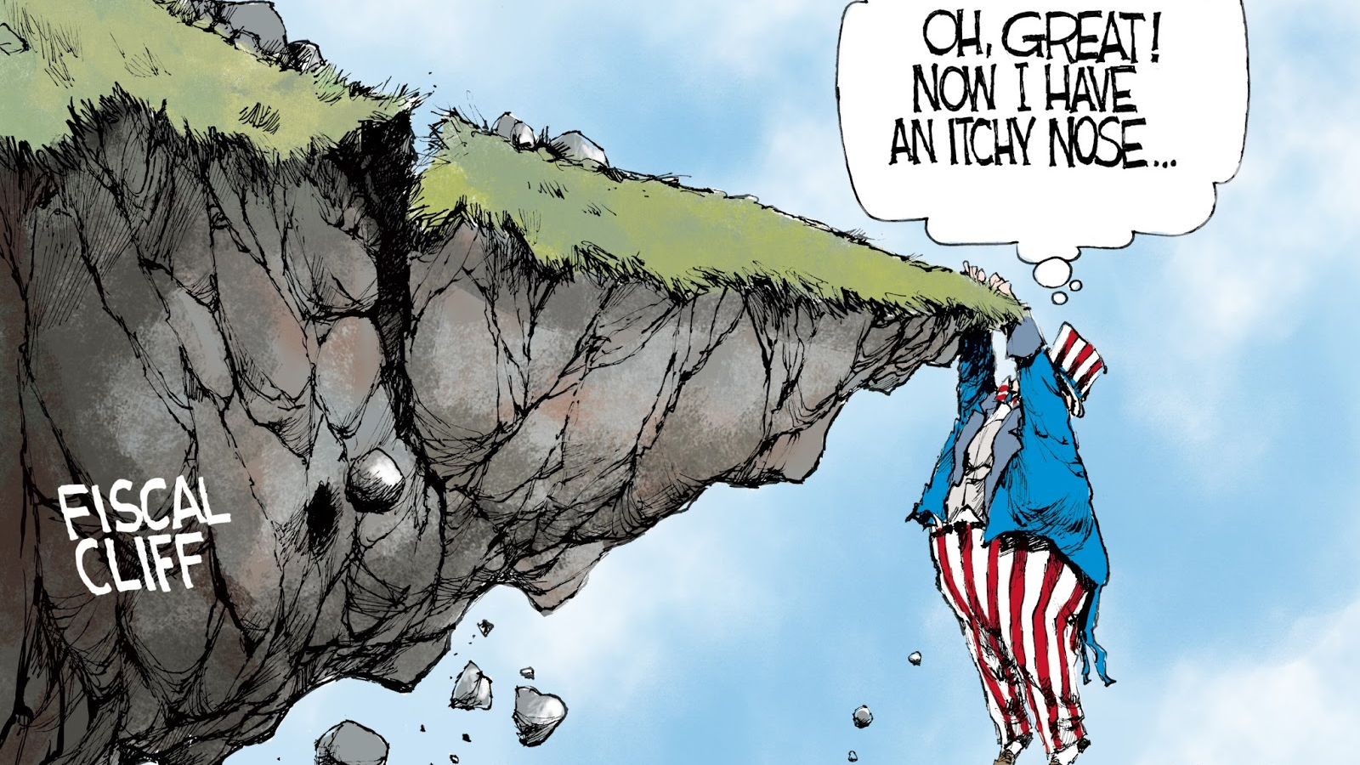

Slide 21
Falling off the Cliff or Taking a Leap?

Slide 24
Keep in Mind
A Reduction in Force is about the loss of positions, not people.
Nevertheless, the end result is the loss of people, friends, and colleagues.
Whether 1 person or 40 people are terminated, a person’s livelihood is being taken away.
Professionalism and empathy are key.

Slide 25
What does all this mean?
Must look for efficiencies on determining where to make cuts:
Remove duplicative positions
Where can we combine positions
What programs can we terminate due to low enrollment/interest
What will we need to sustain the organizational structure of the College?
Employee performance/evaluations can be considered when multiple people serve in a similar position that is being eliminated.

Slide 26
Preliminary Determination
Administration must determine the need for a RIF:
Grounds: financial, declining enrollment, or reorganization.
This analysis must begin now with Finance and HR working together to predict budgetary shortfalls for 2024-2025 and the impact on staff.
Administration must determine which positions are subject to the RIF using the policy considerations:
Efficiencies,
Organizational needs,
Programming needs, etc.

Slide 27
Preliminary Determination
If policy requires, President/Administration outlines a general recommendation to the Board
The grounds for the RIF,
Number of employees to be reduced,
Rational/data supporting the recommendation.
Practice Tip: Include criteria used to select employees.
With a few exceptions, this is an open session topic.
If required, the Board will approve whether to reduce the number of employees or reduce terms of employment.

Slide 28
RIF Criteria
Work Performance and evaluations
Areas of licensure
Program enrollment
Service in extra duty positions and ability to fill such positions
Length of service, with higher priority given to the school system
Degree level
Administration may set other general criteria, such as:
Focus on temporary employees
Focus on employees with less than 3 years of experience in the district

Slide 29
Apply the Criteria
Choose the employees – SHOW YOUR WORK
Provide employees with Due Process found in policy
Basic notice of the reasons
Appeal based on policy

Slide 30
Hearings (if required in policy)
Hearings:
Held separately
Closed session
General due process rights apply
Approval is in open session
No hearing requested
Board may discuss employees as a whole, or individually, in closed session
Board may accept, reject, or modify the recommendations

Slide 31
Preparing for the Cliff

Slide 32
Preparing for the Cliff
Create a RIF Committee
Document the reasons for the RIF
Determine which criteria will be used
Facing a large RIF, create a separate review committee to defend against any potential litigation (the Board could serve in this function)

Slide 33
Preparing for the Cliff
Determine if and when to institute a hiring freeze for impacted positions.
What’s the financial number and how many employees does that equate to?
Understand current and future needs.
How will attrition assist in reducing the number of employees?
Gain understanding of attrition early.
In the end – How many positions will be eliminated and where are the positions located?

Slide 34
Preparing for the Cliff
Is the RIF a broad reduction of employees, or more surgical focusing on a few small areas?
A RIF is an opportunity to reduce employees not performing adequately.

Slide 35
Preparing for the Cliff Ancillary Financial Impact
Unemployment Increase
Health Benefit for Reduced Employees (G.S. §135-48.40(b)(8))
Any employee with health benefits
That has worked for at least 12 months
Whose job is eliminated because of a reduction in funds used to support the position
Can continue partial contributory coverage for a period of 12 months following job elimination
Or until the employee finds employment that offers health coverage on a non-contributory basis

Slide 36
Preparing for the Cliff Performance Considerations
Administration needs significant input into which employees may be subject to the reduction based on the criteria set out in policy, or as selected by the President.
Evaluate employees honestly. Using performance standards/ratings as reason for reduction requires excellent record keeping.
Look over evaluations from past several years as well but understand they were not written with a RIF in mind.
If supervisor has difficulty in evaluating a problem employee, have another administrator also evaluate to obtain a second opinion.

Slide 37
Preparing for the Cliff Legal Review
Consult with counsel and perform a disparate impact analysis
Does the RIF disproportionately impact a protected class?
Does business necessity (based on non-discriminatory reasons) outweigh the disparate impact?
For large reductions, there are actual statistical and practical tests to assist in determining disparate impact.
Four-Fifths rule: disparate impact exists if protected class members are selected at rates of more than four-fifths (80%) of the rate for the group with the highest selection.

Slide 38
Preparing for the Cliff Communication Plan
Do you inform impacted employees together or separately?
Don’t screw this up with impersonal notification,
Personal notification must be in writing with all due process rights outlined,
Final letter should clearly state termination is due to a reduction in force.
Be prepared to communicate to all staff.
Avoid low morale,
Address the reasons for the RIF, and
Address changes in employees’ duties.
Determine what, if any, public communications are necessary.

Slide 39
Preparing for the Cliff Mitigating Options
Furlough/leave without pay or reduction of total hours.
Reduction of days/hours does not require state approval (for classified employees),
Ex: Reduce Instructional Assistants to 178 days, 7 hours per day.
Voluntary attrition – Ex. new mother decides to take a year off.
Termination of temporary employees.

Slide 40
Preparing for the Cliff Mitigating Options
Voluntary severance or retirement incentive
Ex: If you choose to retire, the College will provide you an incentive of $_____ (i.e., less than health insurance requirement),
Voluntarily eliminates highest paid employees,
Plan must be voluntary and cannot be discriminatory,
Review with counsel,
Draft releases for voluntary severance or retirement plans,
Generally, these payments are not "compensation" for retirement,
Timing of offer is critical.

Slide 41
Governance Changes

Slide 42
Board Restructuring
Group 1: The General Assembly will now appoint eight (8) trustees. The Legislature will appoint two (2) members annually, one upon the recommendation of the Speaker of the House and one upon the recommendation from the President Pro Tempore of the Senate.
These appointments require passage of a bill.
These appointments "replace" Governor and BOE appointments.
Does not impact current members of the BOT who should serve out remainder of terms; new Group 1 appointments should begin when Governor/BOE appointments roll off.

Slide 43
Group 1
Ensure your trustee information is up to date and determine the length of any remaining terms of any appointments made by the Governor or local board(s) of education.
When Governor/BOE terms expire, ensure your local legislative delegation are aware the Legislature will need to make an appointment.
Make recommendations to your local delegation; have your county or BOE also make recommendations.
Appointments may be from a contiguous county.

Slide 44
Group 2
Four (4) trustees elected by the county commissioners of the county where the main campus of the college is located.
Two (2) trustees elected by the county commissioners of any county in the college’s administrative area that provides "plant funds" to the college.
Each county can appoint one commissioner.
Plant Funds: The "tax-levying authority of each institution shall be responsible for providing adequate needs" for the following budget items:
Acquisition of land; erection of all buildings; alterations and additions to buildings; purchase of automobiles, buses, trucks, and other motor vehicles; purchase or rental of all equipment necessary for the maintenance of buildings and grounds and operation of plants; and purchase of all furniture and equipment not provided for administrative and instructional purposes.

Slide 45
Group 2 Delegation
Special Note for Group 2: County commissioners may delegate the election of one or more of its trustee appointments to a board of education. If the commissioners do delegate, the following rules apply:
The delegation expires at the end of the trustee’s term but may be renewed by the county.
If the college’s administrative area contains more than one local school administrative unit, the county may delegate the election to those units jointly, meaning the boards of education would have to agree on the person elected as a trustee.
If the board(s) of education has not elected a trustee by May 1, the county shall revoke the delegation and elect the trustee(s).

Slide 46
Group 2
If the college’s administrative area includes a county that did not previously receive appointments (or the county only had 1 seat), but the county does provide plant funds to the college, the county may now elect two trustees.
This may occur immediately, but new Trustee(s) would not take place until July 1.
Talk to the county commissioners on how best to structure appointments.
Potentially stagger appointments (1 in 2024, 1 in 2025/26)

Slide 47
Group 2 Scenarios
Can the county (A) delegate their appointment power to another county (B) in the service area?
Not really, but County A could appoint someone that lives in County B.
Can County A agree to appoint someone from County B?
Potentially, yes, but all parties would need to be in agreement.
"All trustees shall be residents of the administrative area of the institution for which they are selected or of counties contiguous to the administrative area."

Slide 48
Group 2 Scenarios
Will brokered deals stand the test of time?
A new group of county commissioners could vacate any agreement or MOU regarding appointment delegations.
Consider asking your legislative delegation for a local act that makes sense for everyone.
[Or asking your county commissioners to do so]
Three colleges already received special provisions . . . .

Slide 49
Special Acts
Mayland CC (Each county gets 2 appointments)
South Piedmont CC (Union – 3; Anson – 2)
Vance-Granville CC (Vance – 4; Granville – 3; Franklin – 2; Warren – 1)
If you find yourself needing a bigger board room after the new legislation, ask your local delegation for a special act to reduce the number of trustees.

Slide 50
Group 3
SGA President/Chair – but only if the Board of Trustees agrees.
Keep your current SGA President,
In the springtime, make a determination about whether the next one will serve.
Two options on how to decide:
Adopt a policy/by-law that applies indefinitely (until changed),
Make an annual determination.

Slide 51
Governance
State Board of Community College approval is now required for the "reelection" of a college president or chief administrative officer.
The term "reelection" is not defined, it will likely be interpreted as an extension of the president’s or chief administrative officer's contract.
Waiting on procedures or potential changes to the NC Community College Code.
Until a rule or policy provision is in place, I recommend submitting contract extensions to the System Office for "approval."

Slide 52
K. Dean Shatley, II Campbell Shatley, PLLC 674 Merrimon Ave., Suite 210 Asheville, NC 28804 (828) 398-2775

