Slide 1
THE INEXTRICABLY INTERTWINED TRAVAILS OF TITLE IX: A SURVEY OF HOT TOPICS NCACCT Legal Seminar March 14, 2024

Slide 2
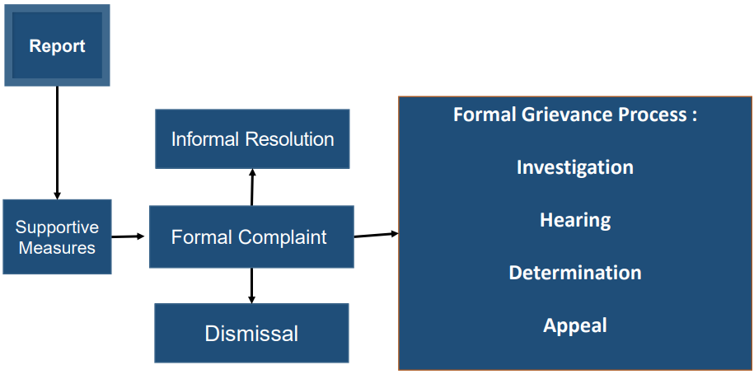

Slide 3
TITLE IX
FUNDAMENTALS

Slide 4
TITLE IX OVERVIEW
Title IX of the Education Amendments of 1972 is a federal civil rights law that prohibits discrimination on the basis of sex in federally funded education programs and activities.
All public and private elementary and secondary schools, colleges and universities receiving any federal financial assistance must comply with Title IX.
The United States Department of Education Office for Civil Rights (OCR) is the entity responsible for monitoring compliance with Title IX.

Slide 5
TEXT OF THE LAW
No person in the United States shall, on the basis of sex, be excluded from participation in, be denied the benefits of, or be subjected to discrimination under any education program or activity receiving Federal financial assistance.
20 U.S.C. §§1681-1688

Slide 6
SEX-BASED DISCRIMINATION
What is sex-based discrimination?
The term is not defined in Title IX.
"The Department follows the Supreme Court's approach in interpreting conduct 'on the basis of sex' to include conduct of a sexual nature or conduct referencing or aimed at a particular sex."

Slide 7
TITLE IX'S 2020 FINAL RULE
November 29, 2018 – Secretary Devos announces intention to restructure
Title IX
November 29 – January 30 – Public comment period
May 6, 2020 – Final Title IX rules announced
August 14, 2020 – Effective/implementation date

Slide 8
TITLE IX'S 2023(/2024) FINAL RULE
July 2022 – Proposed new Title IX regulations announced
Public comment period received over 240,000 comments
??? – Final Title IX rules announced
??? – Effective/implementation date

Slide 9
WHAT CONDUCT IS COVERED?
Allegations of sexual harassment that occur in an education program or activity located within the United States and of which the recipient has actual knowledge.
If a person alleges misconduct that fits in the above description, institutions have a duty to respond. The Title IX Final Rule sets out your legal obligations in responding to such allegations.

Slide 10
KEY DEFINITIONS
Actual Knowledge – notice of allegations of sexual harassment by the Title IX Coordinator or any college official who has authority to institute corrective measures on behalf of the college.
Sexual Harassment - quid pro quo harassment; unwelcome conduct that a reasonable person would find so severe, pervasive, and objectively offensive that it effectively denies a person equal access to the College's education program or activity, including conduct based on sex stereotyping; or any instance of sexual assault, dating violence, domestic violence, or stalking.
Education Program or Activity – any locations, events, or circumstances over which the College exercised substantial control over a Respondent and the context in which the alleged sexual harassment occurs, including any building owned or controlled by a recognized student organization.

Slide 11
SEXUAL HARASSMENT DEFINITION
Quid pro quo harassment – conditioning the provision of an aid, benefit, or service of the school on a person's participation in unwelcome sexual conduct
Unwelcome conduct that a reasonable person would find so severe, pervasive, and objectively offensive that it effectively denies a person equal access to the school's education program or activity, including conduct based on sex stereotyping
Sexual assault, as defined in the Clery Act, or dating violence, domestic violence, or stalking as defined in VAWA

Slide 12
Only applies to employee respondents who condition, aid, benefit, or service on unwelcome sexual conduct.
No restriction on complainant's status.
DOE interprets this broadly to encompass implied quid pro quo.
No intent, or severe or pervasive requirements but must be unwelcome.
SEXUAL HARASSMENT: QUID PRO QUO

Slide 13
SEXUAL HARASSMENT: DAVIS/GEBSER
Does not require intent.
Reasonable person in the shoes of the complainant.
Takes into account different circumstances.
Very fact-specific.

Slide 14
Rape
Sodomy
Sexual Assault with an Object
Fondling
Incest
Statutory Rape
SEXUAL HARASSMENT: SEXUAL ASSAULT

Slide 15
SCOPE: EDUCATION PROGRAM OR ACTIVITY
"Education Program or Activity"
All the operations of a College, University, or other post-secondary institution
Includes: locations, events or circumstances over which the recipient exercised substantial control over both the Respondent and the context in which the harassment occurs
Includes: Any building owned or controlled by a student organization that is officially recognized by a postsecondary institution

Slide 16
WHAT RESPONSE IS NECESSARY?
Must not be deliberately indifferent.
"Deliberate indifference" = unreasonable in light of known circumstances.

Slide 17
HOT TOPIC #1: NEW REGS!

Slide 18
SHIFT IN FRAMEWORK
2020: Deliberate Indifference
Actual knowledge
Deliberate indifference
Narrow definitions and scope
Formal complaint to trigger action
Rigid application at every level
2023/24: Aspirational
“[M]ust take prompt and effective action to end any sex discrimination that has occurred in its education program or activity, prevent its recurrence, and remedy its effects.”
Maintains and expands core requirements re: notice and opportunity to be heard
Builds in flexibility at stages throughout the grievance process

Slide 19
2023/24 REGULATIONS: TOP 6 CHANGES
A Complainant is no longer required to submit a “Formal Complaint” to initiate the grievance process; the process can be initiated with an oral request.
It will be permissible for a single individual to serve as the investigator and decision-maker.
No mandatory dismissals.
Institutions will need to address a sex-based hostile environment in its education program or activity when sex-based harassment occurred outside the institution's education program or activity.
Changes "severe AND pervasive" to "severe OR pervasive" re: "unwelcome conduct".
Live hearings will not be required.

Slide 20
HOT TOPIC #2: THE IMPACT OF SOCIAL MEDIA

Slide 21
THE USE OF TECHNOLOGY TO OBTAIN EVIDENCE
Current Title IX Regulations require institutions to:
“objectively evaluate all relevant evidence, including inculpatory and exculpatory evidence;”
“not restrict the ability of either party to . . . gather and present relevant evidence;”
“make all such evidence subject to the parties’ inspection and review available at any hearing to give each party equal opportunity to refer to such evidence during the hearing, including for purposes of cross-examination.”
Notes:
Some of the comments on the proposed regulations focused on student privacy, and institutions’ use of monitoring or reviewing electronic media. Colleges do not have a general obligation to monitor or surveil students or employees online, but a lot of Title IX investigations involve online/electronic activity, including text messages, social media messages, social media platforms such as TikTok, email, etc. The burden is on the College to gather evidence in a Title IX investigation, and that can mean an investigator doing an independent investigation into the parties’ social media/electronic use, if that is an issue in the investigation. One issue that recent comments to the proposed regulations pointed out was that monitoring students or employee's media can have unintended privacy consequences, and may subject institutions to liability, such as an invasion of privacy claim. I haven’t seen this issue litigated, but it is something Colleges should be aware of, balancing their responsibility to investigate and how much investigation that entails, if the parties are not volunteering evidence.

Slide 22
PEER HARASSMENT & RETALIATION
Feminist Majority Foundation v. Hurley, 911 F.3d 674 (4th Cir. 2018).
The use of Social Media to impersonate a Peer.
The use of Social Media to extort.
Notes:
FMF was a student organization at the University of Mary Washington, a public university in Virginia. In 2014, the University’s student body authorized male-only fraternities on campus. At the townhall meeting, a Feminist United member questioned the allowance of the fraternities given research that showed how Greek life increased the number of sexual assaults. Afterwards, the issue was debated on Yik Yak, a now-defunct social-media application where users posted comments anonymously. On November 21, 2014, UMW students yelled “fuck the feminists” at Feminist United students leaving a meeting with UMW’s Title IX coordinator, Dr. Leah Cox. After a video emerged of the men’s rugby team performing a chant that glorified violence against women, Feminist United members met with UMW President Hurley (defendant). On March 11, 2015, Hurley held a townhall, where Hurley downplayed the rugby team’s actions. After outrage, Hurley suspended all rugby activities and directed the rugby team to undergo anti–sexual assault and violence training. The rugby team lashed out by posting physically and sexually threatening messages about the feminist students on Yik Yak. On March 25, 200 examples of violent Yik Yak messages were presented to Hurley, and the feminist students asked him to bar access to Yik Yak on campus. However, UMW took no such actions. On April 17, 2015, a Feminist United member was killed by her roommate. In the immediate aftermath, Feminist United members did not know that the death was not connected to the threatening Yik Yak messages. FMF and Feminist United sued Hurley for violations of Title IX to the Education Amendments of 1972, 42 U.S.C. § 1983, and the Equal Protection Clause of the Fourteenth Amendment.
The district court dismissed the plaintiffs’ Title IX claim for sex discrimination, reasoning that the university did not have sufficient control over the context of harassment that largely transpired online.
The Fourth Circuit vacated that dismissal, concluding the plaintiffs’ complaint survived a motion to dismiss. The panel majority reasoned that although much of the alleged harassment occurred online, the university nonetheless maintained substantial control over the conduct because the harassment “actually transpired on campus.” In particular, “harassing and threatening messages originated on or within the immediate vicinity” of the university campus. Some of the messages were posted using the school’s wireless network, and the harassment “concerned events occurring on campus and specifically targeted” certain university students.
According to the complaint, the university had the ability to identify and discipline students who posted the messages. The Fourth Circuit accordingly ruled that the plaintiffs had sufficiently alleged facts to establish that the university had substantial control over the context of the harassment and could exercise disciplinary authority over the responsible students.
Social Media to impersonate a peer: Manti Te’o, infamous girlfriend hoax. This was happening when he was in college, and even the trailer for the documentary says it affected how he played football, which is considered an education program or activity of Notre Dame. Under the current and proposed regs, he could file a Title IX Complaint to essentially ask the university to investigate whether he was being sexually harassed by the online activity of the person cat-fishing him.
Social Media to Extort: the ex-Northeastern University track coach has been accused by the FBI of targeting female student-athletes. The former coach, 28 years old, is accused of cyberstalking at least one student and trying to extort nude photographs from several others. He was fired in 2019 after a Title IX investigation and arrested in 2021. In his 4 months of employment with the Boston university, he allegedly hacked into the student’s Snapchat account and sent stolen nude photos of her to herself and her boyfriend. He also allegedly stole compromising photos of five other students from their cellphones and attempted to extort, stalk, and harass them through dummy social media accounts.
These are just a few of the examples of how social media has impacted students’ lives, employees’ lives, and colleges’ obligations under Title IX. Good or bad, right or wrong, social media is very much a part of students’ lives in particular, and the trend of social media use is not going to decrease any time soon.

Slide 23
HOT TOPIC #3: THE INTERSECTION OF PROHIBITED OR “CONSENSUAL” RELATIONSHIPS POLICIES WITH TITLE IX

Slide 24
CONSENSUAL RELATIONSHIPS AND THE TITLE IX REGULATIONS
Commenters urged the DOE to clarify that a consensual relationship between a student and faculty member would “count” as sexual harassment because the relationship is an abuse of the faculty member’s power over the student.
DOE wrote, in preamble:
Requested prohibition was covered by the quid pro quo harassment definition.
QPQ nature of the incident could be “implied from the circumstances.”
When a Complainant acquiesces to unwelcome conduct in a QPQ context, such “consent” does not mean the conduct was welcome.

Slide 25
CONSENSUAL RELATIONSHIPS AND THE TITLE IX REGULATIONS
No explicit requirement to have a consensual relationships policy.
Evaluate under:
Quid Pro Quo
Hostile Environment+
Unwelcome
Severe, pervasive, and objectively offensive
Effectively denies equal access
Sexual Assault

Slide 26
CONSENSUAL RELATIONSHIPS AND THE TITLE IX REGULATIONS
May also evaluate/consider:
Conflict of interest policies
Handbook or Code of Conduct
Employment agreement??

Slide 27
POLICY OPTIONS
Are there any circumstances when employees and students can engage in consensual relationships?
Pre-existing relationships
Those that are disclosed to the College
Which employees and which students are covered by the policy?
High school students versus Adult learners
No Policy Advisory/Discouragement Prohibition

Slide 28
CONSIDERATIONS
Does the College require the employee to disclose the relationship?
If the College prohibits the relationship, what are the consequences to the employee and the student?
What steps would the College take to evaluate whether there was a prohibited relationship if both parties deny it?
Are there existing grievance procedures to address consensual relationships policy violations?

Slide 29
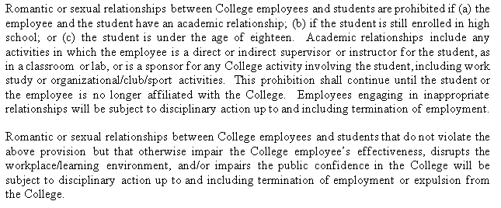
MODEL POLICY

Slide 30
Campbell Shatley, PLLC 674 Merrimon Ave., Suite 210 Asheville, NC 28804 (828) 398-2776

